Slide 1
电子商务法中的知识产权条款 Clauses Concerning Intellectual Property Right in the E-commerce Law
刘强 中南大学法学院教授/博士生导师
Prof. LIU Qiang
Law School of Central South University
Director of Ph. D. Candidate

Slide 2
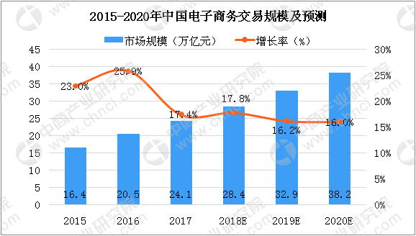
《中华人民共和国电子商务法》
（2018年8月31日第十三届全国人民代表大会常务委员会第五次会议通过）
E-commerce law of People's Republic of China
中商产业研究院整理

Slide 3
《电子商务法》知识产权条款三大特点：
责任主体类型化：平台经营者+平台内经用者
处理规则法定化：通知+反通知
法律责任多样化：针对电子商务平台经营者设置行政处罚
The three characteristics of the intellectual property clause of the electronic commerce law:
Classification of the main body of responsibility: platform operators + users in the platform.
legalization of procedure rules: notification + counter notification
Diversification of legal liability: Setting Administrative Penalties for the operator of electronic commerce platform

Slide 4
电子商务经营者知识产权保护的原则规定
电子商务经营者从事经营活动，应当遵循自愿、平等、公平、诚信的原则，遵守法律和商业道德，公平参与市场竞争，履行消费者权益保护、环境保护、知识产权保护、网络安全与个人信息保护等方面的义务，承担产品和服务质量责任，接受政府和社会的监督。（第五条）
In conducting business activities, e-commerce operators shall abide by the principles of voluntariness, equality, fairness and good faith, abide by laws and commercial ethics, participate in market competition fairly, fulfill their obligations in the protection of consumers' rights and interests, environmental protection, intellectual property protection, network security and personal information protection, undertake thequality of products and service, and accept the supervision of the government and society.（Art. 5 ）

Slide 5
一、责任主体类型化
电子商务经营者：通过互联网等信息网络从事销售商品或者提供服务的经营活动的自然人、法人和非法人组织。（第九条 第一款）
E-commerce operators refer to natural persons, legal persons and non-legal organizations engaged in the business activities of selling goods or providing services through information networks such as the Internet.（Art. 9 Sec.1）

Slide 6
①电子商务平台经营者：在电子商务中为交易双方或者多方提供网络经营场所、交易撮合、信息发布等服务。operators of e-commerce platforms, provides network business place, transaction matching, information release and other services.
②平台内经营者：通过电子商务平台销售商品或者提供服务的电子商务经营者。operators within platforms,e-commerce operator who sells goods or provides services through an e-commerce platform
③通过自建网站销售商品或者提供服务的电子商务经营者e-commerce that sells goods or provides services through self-built websites
④通过其他网络服务销售商品或者提供服务的电子商务经营者。other network services operators

Slide 7
二、处理规则法定化
知识产权保护规则制定义务：电子商务平台经营者应当建立知识产权保护规则，与知识产权权利人加强合作，依法保护知识产权。（第四十一条）
Obligation to make rules for intellectual property protection:Operators of e-commerce platforms shall establish rules for the protection of intellectual property rights, strengthen cooperation with owners of intellectual property rights and protect intellectual property rights according to law. （Article 41）
电子商务平台经营者责任性质：补充责任→连带责任→独立责任。The responsibilities of e-commerce platform operators are supplementary responsibilities→joint liabilities→independent responsibilities.

Slide 9
权利人发出通知：知识产权权利人认为其知识产权受到侵害的，有权通知电子商务平台经营者采取删除、屏蔽、断开链接、终止交易和服务等必要措施。通知应当包括构成侵权的初步证据。（第四十二条 第一款）
Where an intellectual property right holder considers that his intellectual property rights have been infringed, he shall have the right to notify the operators of e-commerce platforms to take such necessary measures as deleting, shielding, disconnecting links, terminating transactions and services. The notice should include preliminary evidence of infringement.（Art. 42 Sec.1）

Slide 10
平台经营者的删除义务（避风港规则）：电子商务平台经营者接到通知后，应当及时采取必要措施，并将该通知转送平台内经营者；未及时采取必要措施的，对损害的扩大部分与平台内经营者承担连带责任。（第四十二条 第二款）
Deletion obligation of platform operators（Safe Harbor Rules）：After receiving the notification, the operator of e-commerce platform shall take the necessary measures in time and transmit the notification to the operator in the platform; if the operator fails to take the necessary measures in time, he shall be jointly and severally liable for the expansion of the damage to the operator in the platform. （Art. 42 Sec.2）

Slide 11
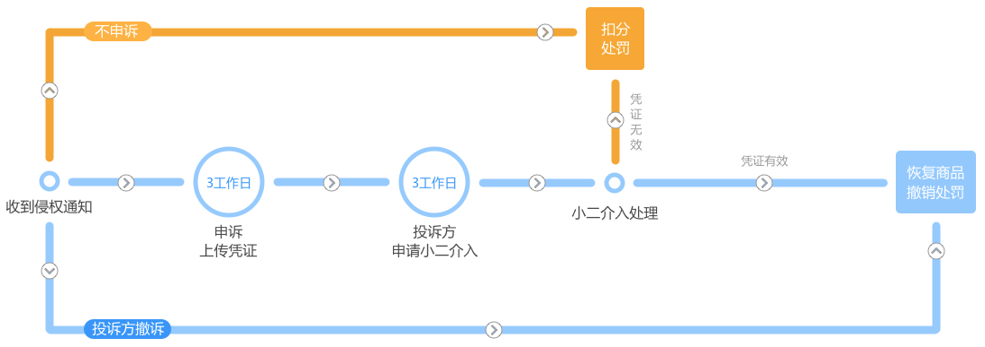

Slide 12
因通知错误造成平台内经营者损害的，依法承担民事责任。恶意发出错误通知，造成平台内经营者损失的，加倍承担赔偿责任。（第四十二条 第三款）
If the operator's injury is caused by the notification error, it shall bear civil liability according to law. Whoever issue malicious notification and cause the loss of the operator in the platform, should undertakes double liability. （Art. 42 Sec. 3）
探讨：恶意发出错误通知构成的主观方面和客观方面？Discussion: The subjective and objective aspects of malicious notification?

Slide 13
反通知：平台内经营者接到转送的通知后，可以向电子商务平台经营者提交不存在侵权行为的声明。声明应当包括不存在侵权行为的初步证据。（第四十三条 第一款）
Upon receipt of the notification of transfer, the operator of the platform may submit to the operator of the electronic commerce platform a declaration that there is no infringement. The statement should include preliminary evidence of no infringement.（Art. 43 Sec.2）

Slide 14
转通知：电子商务平台经营者接到声明后，应当将该声明转送发出通知的知识产权权利人，并告知其可以向有关主管部门投诉或者向人民法院起诉。电子商务平台经营者在转送声明到达知识产权权利人后十五日内，未收到权利人已经投诉或者起诉通知的，应当及时终止所采取的措施。（第四十三条第二款）
Transfer notification: After receiving the declaration, the operator of the electronic commerce platform shall transmit the declaration to the intellectual property right holder who issued the notification, and inform him that he may complain to the competent authorities or bring a suit in the people‘s court. Within 15 days after the transfer declaration arrives at the intellectual property right holder, the operator of the electronic commerce platform shall terminate the measures taken in time if he has not received the notice of complaint or prosecution from the right holder.（Art.43 Sec.2 ）

Slide 15
探讨：被投诉者不能利用反通知立即解除平台经营者采取的断开链接等措施。需要等待十五天时间以确定权利人是否起诉。这是否构成实质性临时禁令？
Doubt: The complainant can not use the counter notification to immediately remove the disconnection link taken by the platform operator. He need to wait for fifteen days to determine whether the right person will prosecute. Does this constitute a substantive priliminary injunction?

Slide 16
公示义务：电子商务平台经营者应当及时公示收到的本法第四十二条、第四十三条规定的通知、声明及处理结果。（第四十四条）
Publicity obligation: The operators of e-commerce platforms shall publicize timely the notifications, declarations and processing results provided for in Articles 42 and 43 of this Law. （Art. 44）
探讨：信息公示是否会造成商业秘密泄露和商誉损害？Will information disclosure cause business secrets to leak and goodwill damage?

Slide 17
三、法律责任多样化
民事责任：电子商务平台经营者知道或者应当知道平台内经营者侵犯知识产权的，应当采取删除、屏蔽、断开链接、终止交易和服务等必要措施；未采取必要措施的，与侵权人承担连带责任。（第四十五条）
Civil Liability: If the operator of e-commerce platform knows or should know that the operator of the platform infringes intellectual property rights, he should take necessary measures such as deleting, shielding, disconnecting links, terminating transactions and services; if he fails to take necessary measures, he shall bear joint and several liability with the infringer. （Art. 45）
探讨：平台经营者是程序性的通知转发者或者实体性的侵权裁判者？第四十二条第二款和第四十五条竞合。Discussion: The platform operator is a procedural notification forwarder or a substantive tort judge? Overlap of Articles 42 Sec.2 and Article 45 of this law.

Slide 18
行政责任：电子商务平台经营者违反本法第四十二条、第四十五条规定，对平台内经营者实施侵犯知识产权行为未依法采取必要措施的，由有关知识产权行政部门责令限期改正；逾期不改正的，处五万元以上五十万元以下的罚款；情节严重的，处五十万元以上二百万元以下的罚款。（第八十四条）
Administrative responsibility: If an operator of an electronic commerce platform violates the provisions of Articles 42 and 45 of this Law and fails to take necessary measures in accordance with the law to infringe upon intellectual property rights, the relevant intellectual property administrative department shall order him to make corrections within a time limit; if he fails to make corrections within the time limit, he shall be fined not less than 50,000 yuan but not more than 500,000 yuan. If the conducts are serious, a fine of more than five hundred thousand yuan or less than two million yuan shall be imposed. （Art. 84）

Slide 19
电子商务经营者违反本法规定，销售的商品或者提供的服务不符合保障人身、财产安全的要求，实施虚假或者引人误解的商业宣传等不正当竞争行为，滥用市场支配地位，或者实施侵犯知识产权、侵害消费者权益等行为的，依照有关法律的规定处罚。（第八十五条）
Where an electronic commerce operator violates the provisions of this law, sells goods or provides services that do not meet the requirements of safeguarding personal and property safety, conducts false or misleading commercial propaganda, abuses its dominant position in the market, or conducts acts such as infringing intellectual property rights, infringing consumers’ rights and interests, etc., he shall be punished according to the provisions of relevant laws. (Art. 85)

Slide 20
谢谢聆听
Thanks for Attention

