Slide 1
EU-China IP Academic Forum, 22 November 2018
MONEY FOR AUTHORS, SUPPORT FOR ©
Prof. Dr. Martin Senftleben

Slide 2
Social legitimacy of copyright
incentive and reward for creative work
measures to ensure appropriate income for authors

Slide 3
Art. 15 Proposed EU Directive on Copyright in the Digital Single Market (DSM Directive)
contract adjustment mechanism
‘Member States shall ensure that authors and performers are entitled to request additional, appropriate remuneration from the party with whom they entered into a contract for the exploitation of the rights when the remuneration originally agreed is disproportionately low compared to the subsequent relevant revenues and benefits derived from the exploitation of the works or performances.’

Slide 4
Germany and the Netherlands
Most advanced national systems
Fair remuneration ex ante
Fair remuneration ex post

Slide 5
FAIR REMUNERATION EX ANTE

Slide 6
Individual creator vs. creative industry
German Copyright Contract Act 2002
  right to fair remuneration ex ante and ex post
  ‘fair’ = customary and honest remuneration in the sector concerned
  establishment of common remuneration rules in negotiations between industry and creators
Dutch Copyright Contract Act 2015
  right to fair remuneration ex ante and ex post
  establishment of common remuneration rules in negotiations between industry and creators

Slide 7
More bargaining power for creators?
German Copyright Contract Act 2002
  § 32(1): right to fair remuneration
  contract modification in case of insufficient remuneration
  § 32(2): ‘fair’ = customary and honest remuneration in the sector concerned
Dutch Copyright Contract Act 2015
  Art. 25c(1): right to fair remuneration
  no need for contract modification because directly enforceable?

Slide 8

Toothless tiger?

Slide 9
Burden of proof
claimant = individual creator
  evidence of customary remuneration?
  evidence of fair remuneration in comparable circumstances
‘common remuneration rules’ as a solution
  result of negotiations between exploiter(s) and a representative association of creators
  legally presumed to be ‘fair’
  sufficient evidence for fair remuneration standard (benchmark function)

Slide 10
Impact in practice
2005: ‘Common Remuneration Rules for Writers of German Fiction’
  compromise after long and difficult negotiations
  intervention by Ministry of Justice
  signed by several publishers but not by the German Publishers’ Association
  application to translated works explicitly excluded

Slide 11
German Supreme Court, 7 October 2009, ‘Talking to Addison’
at issue: fair remuneration for translators of fiction
analogous use of common remuneration rules for writers of fiction as a guideline
concrete result: right to one fifth of the remuneration of writers
  2% sale’s price hardcover
  1% sale’s price pocket editions
  if fixed honorarium guaranteed: 0,8% hardcover; 0,4% pocket after 5000 copies have been sold

Slide 12
German Supreme Court, 7 October 2009, ‘Clash of Fundamentalisms’
at issue: fair remuneration for translation of a book of popular science
analogous application of remuneration rules for writers of fiction as a guideline
double analogy
  translators instead of writers
  science instead of fiction
approach confirmed in later decisions
  German Supreme Court, 21 May 2015, ‘GVR Tageszeitungen I’

Slide 13
Does this jurisprudence make sense?
= impact on the whole sector
broadening of beneficial effect of existing CRRs
deterrent effect on conclusion of new CRRs

Slide 14
FAIR REMUNERATION EX POST

Slide 15
Bestseller clauses
§ 32a German Copyright Act
  requires ‘striking’ disproportionality between honorarium and revenue accruing from sales
  former bestseller clause required ‘gross’ disproportionality
  debate about right percentage (20%? 50%?)
Art. 25d(1) Dutch Copyright Act
  requires ‘severe’ disproportionality
challenge in both jurisdictions: passing on responsibility in distribution chain

Slide 16
Impact in practice
to revenue share reflecting market success
from fixed lumpsum honoraria

Slide 17
OPEN QUESTION

Slide 18
International dimension
‘New business models are increasingly based on providing access to digital content through streaming of data. In 2015, revenue from e-trade surpassed physical trade for the first time in the music industry.
In this new context, authors and other rightholders complain of lack of remuneration for their rights in the digital environment, producers and cultural industry complain of a “value gap” in the amount due for their rights.’ (WTO Doc. JOB/GC/113/Rev.1 of 7 March 2017)

Slide 19
Towards a Modern, More European ©
interdependence of diverse creative content and innovative online services
‘Both — creative content and online services — are important for growth and jobs and the success of the internet economy.’ (p. 9)
but: risk of a value gap
‘There is, however, growing concern about whether the current EU copyright rules make sure that the value generated by some of the new forms of online content distribution is fairly shared…’ (p. 9)

Slide 20
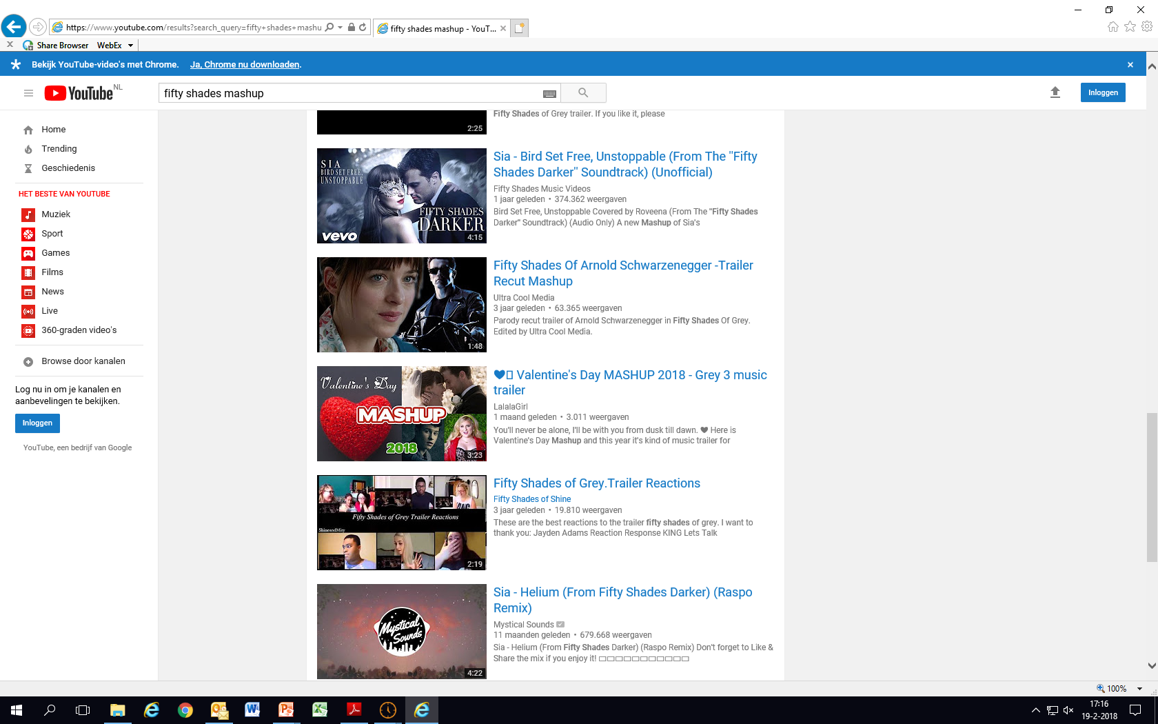
Focus on content platforms

Slide 21
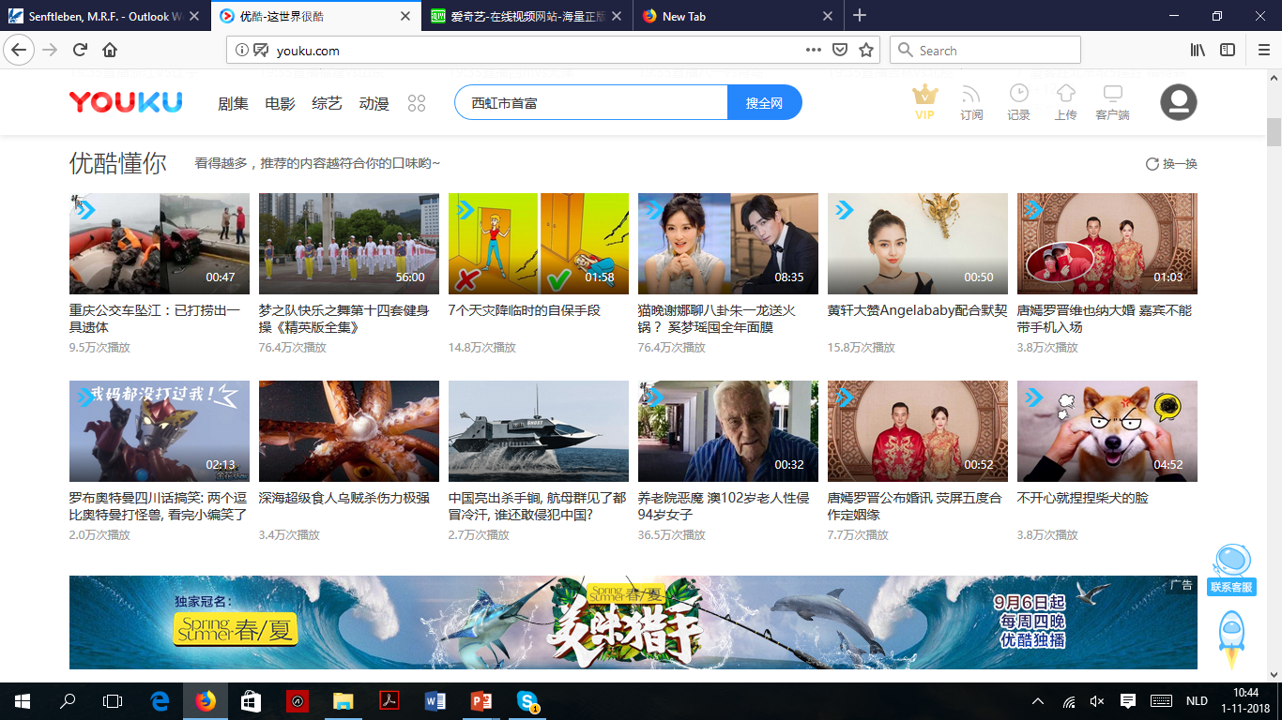
Video sharing platforms

Slide 22
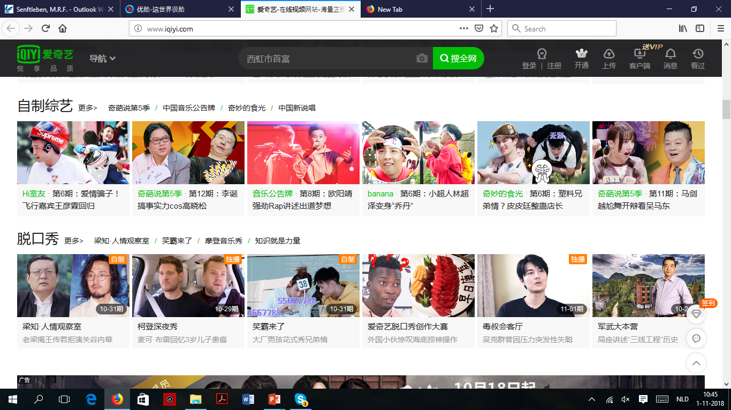
Video sharing platforms

Slide 23
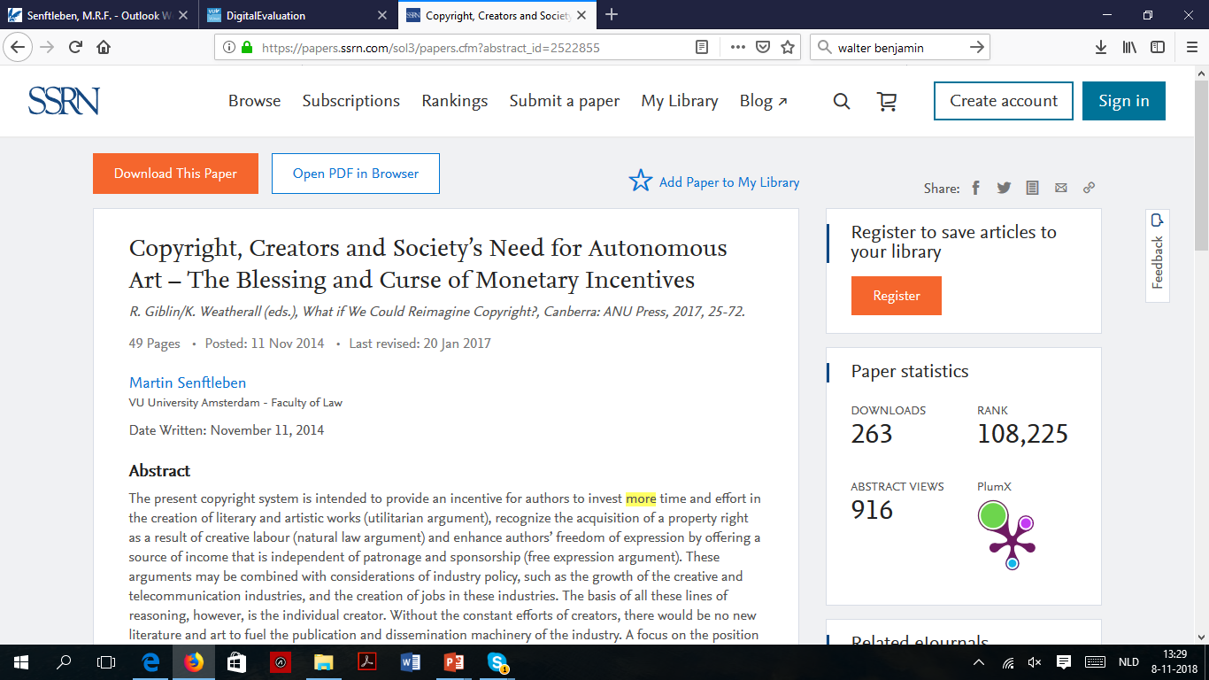
https://ssrn.com/abstract=2522855

Slide 24
THE END. THANK YOU!
Contact: m.r.f.senftleben@vu.nl

