Slide 1




“The role of a national Office in relation to enforcement of IPR – Danish Best Practice”
Mexico City, November 13, 2018
By
Janne Hedegaard (jhw@dkpto.dk)
Principal project adviser
Policy, Legal Affairs and International Projects

Slide 2

Mission
The Danish Patent and Trademark Office
is the centre for strategic information and protection of technology and business identifiers
Notes:
2

Slide 3
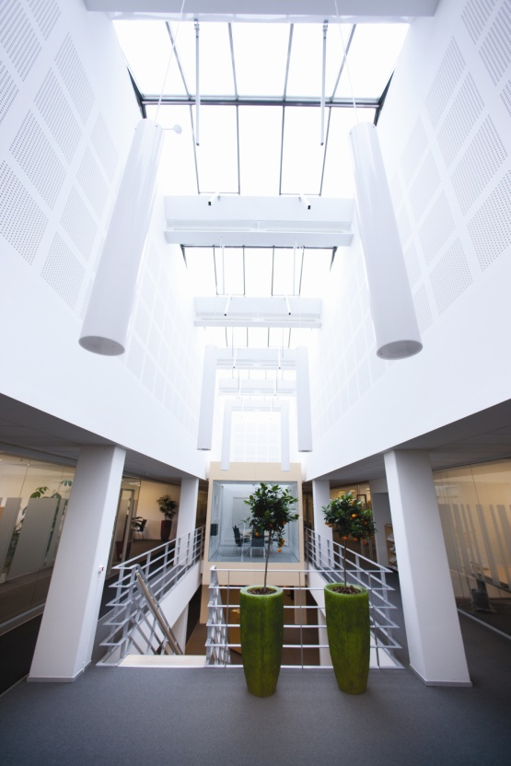
The Danish Patent and Trademark Office
Established in 1894
Two locations in Denmark
Approx. 200 employees
ISO9001:2015 certified
Operate PCT through Nordic Patent Institute
Self financed

Slide 4
The Danish Patent and Trademark Office
Issue: National patents
Conduct: PCT search and examination
through NPI
Register:
  Trademarks
  Utility models
  Designs
Other tasks:
  Legal/Political advice
  Represents Denmark in
  international organisations
  Business services
  International Projects
2017:
Turnover 209 mill. EUR
Business service 1,8 mill. EUR
956 Danish Patent applications
370 Subcontracting
2,959 Danish Trademark applications
107 Danish Design applications
131 Danish Utility model applications
Current international projects:
Iran, Brazil, Argentina and Serbia

Slide 5
Agenda
The Danish Ministerial Network against IPR infringements
”Hotline on counterfeiting”

Slide 6


The Danish Ministerial Network against IPR Infringements
- Established in 2008
Participants:
State Prosecutor for Serious Economic and International Crime
National Commissioner of Police
Ministry of Culture
Danish Customs
Danish Safety Technology Authority
National Competition and Consumer Authority
Danish Veterinary and Food Administration
Danish Medicines Agency
Ministry of Foreign Affairs
Danish Agrifish Agency
Danish Business Authority
Danish Patent and Trademark Office (Secretariat for the Network)
Notes:
Based on a report drafted by relevant line ministries and institutions/agencies
Report was presented by Deputy Prime Minister.
The Network also has a Memorandum of Understanding.
There is no government decree as such but since the report was presented a minister, it’s considered binding for the participating institutions
The kick-start for the development of a report and establishment of the Network was the that the Prime Ministers wife in 2006 during a state visit was carrying a fake Louis Vuitton handbag. That caused a big scandal.

Slide 7

The Danish Ministerial Network against IPR Infringements
The Network was established to:
Improve coordination and knowledge sharing between public authorities
Ensure the drive in the fight against counterfeiting and piracy
Create Awareness for Consumers and Businesses
Continuous dialogue with the industry
Implementation of initiatives from the 2008 cross-ministerial report
(e.g. higher penal sanctions up to 6 years imprisonment)

Slide 8

The Danish Ministerial Network against IPR Infringements
How we work - I
No governmental decree for the Network in legislation
(but could be established in the future)
Established on the basis of a cross-ministerial report on figthing
counterfeiting and piracy (from 2008) + Terms of Reference
No rules on decision-making processes
Notes:
Based on a report drafted by relevant line ministries and institutions/agencies
Report was presented by Deputy Prime Minister.
The Network also has a Terms of Reference setting out the conditions and obligations for the participants.
There is no government decree as such but since the report was presented a minister, it’s considered binding for the participating institutions
The kick-start for the development of a report and establishment of the Network was the that the Prime Ministers wife in 2006 during a state visit was carrying a fake Louis Vuitton handbag. That caused a big scandal.
No rules on decision-making processes
- so in principle unanimity
- but so far not a problem in practice

Slide 9

The Danish Ministerial Network against IPR Infringements
How we work - II
Plenary meetings:
Two annual plenary meeting on pre-established dates
(March and September)
The 12 authorities take turns in hosting the meetings (1 day)
All Network members must participate each time or find a substitute

Slide 10

The Danish Ministerial Network against IPR Infringements
How we work - III
Recurring agenda points as well as ad hoc topics
All authorities contribute to the dialogue
Main advantage: The Network has fostered close working relationships and coordination between the authorities
Also cooperation on international enforcement actions

Slide 11

Cooperation on international enforcement actions
Recurring actions:
Operation Opson (counterfeit food)
Operation In Our Sites (closing down commercial websites engaged in sale of counterfeit goods or copyrighted works)
Operation Pangea (falsified medicine)
Notes:
The Danish Patent and Trademark Office contributes heavily to the international enforcement actions.
For instance, setting up temporary hotlines where the public can get more information on Trademarks, Patents, Designs.
Also we are able to refer to other institutions, like the the Food Safety Agency, Police etc.

Slide 12
Structured dialogue meetings with the industry
2 annual meetings on recurring dates between the Network and the industry representatives (May and November)
The topic changes (and also the participants)
The Network and the industry representatives decide on the topics together
The flexible set-up facilitates meaningful and relevant meetings!
Notes:
The Network circulates a list of topics to be discussed with the Industry.
The meetings are very different – sometimes very formalised and some not so much.
For instance; we had one meeting with 10 participants invited where the purpose was to agree a standard template for consumers to use when to file a police complaint about counterfeited products or infringements to consumers intellectual property rights.
Another meeting had a 120 participants, and took place at the Copenhagen University and was a debate on Copyright in the online environment.
A third plenary meeting was used to receive the Industries feedback on the revision of the EU IPR enforcement directive (Primo 2016)

Slide 13
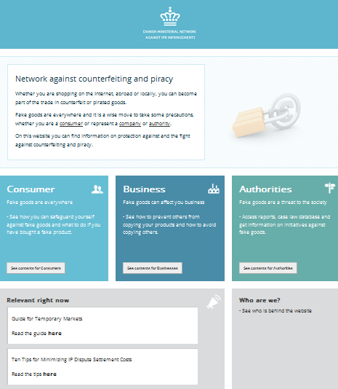
The Network website:
www.stopfakes.dk
Guides for consumers and businesses
Case Law database
  (all criminal cases since 2013)
News (in Danish)
Reports/statistics
Legislation
Notes:
Currently there is around 2000 visitors on the Danish website and around 300 visitors on the English website.
We are very proud of the Case Law database however it is actually an excel sheet. DKPTO is currently applying for funds from EUIPO to create a more searchable database with a better user interface.

Slide 14
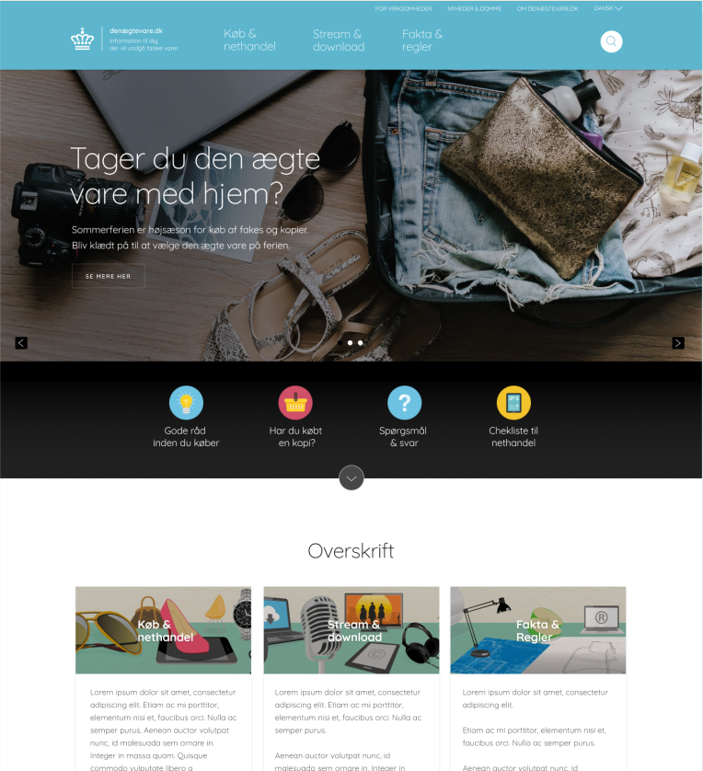
The Network website – stopfakes.dk
New layout, user friendly, modern looking
Targeted consumers, secondarily enterprises

Slide 15
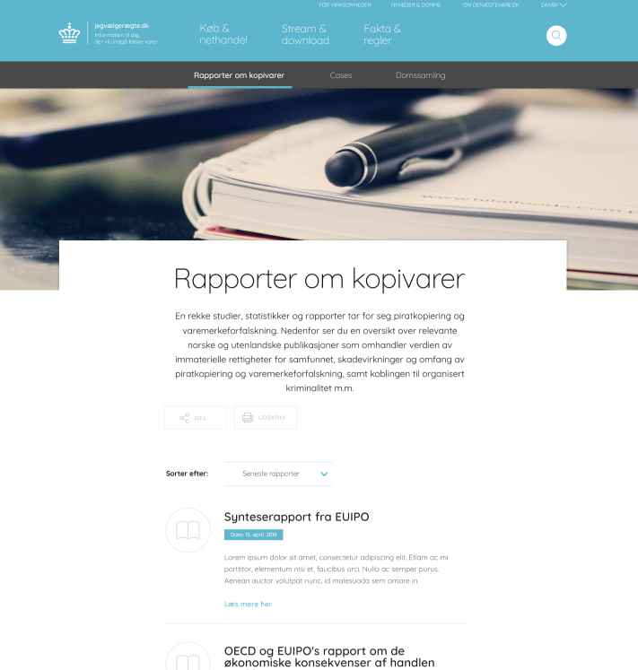
stopfakes.dk content
Guides for consumers
and business
Case law database
News
Reports/statistics

Slide 16
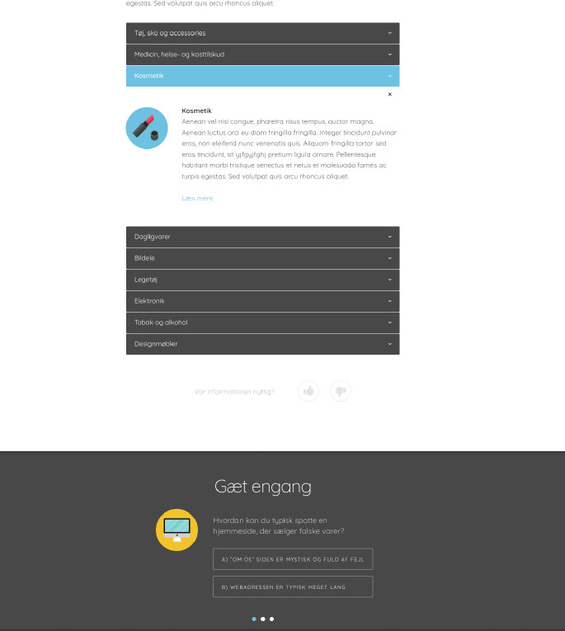
stopfakes.dk new features
Accordion
“Did you know” + “Quiz”
Notes:
Accordion - provide information without taking up to much space on the site.
“Did you know” + “Quiz” – making the page interactive, hoping that the users will spend more time on the page, and get more useful information on counterfeiting and piracy.

Slide 17

Capacity building for enforcement authorities
3-day course in Denmark (both in 2013, 2014 and again in 2017)
Participants from Denmark, Sweden, Norway, Finland, Estonia, Latvia, Lithuania, Iceland, Poland, and Serbia
- Police, prosecutors, customs authorities
- from Denmark also the Danish Health and Medicines
Authority, the Danish Veterinary and Food Administration and
the Danish Patent and Trademark Office
Tailor-made seminars with specific topics
(Organised by DKPTO / Danish State Prosecutor for Serious Economic and International Crime / The Observatory / Europol)
Financed by the EUIPO Observatory

Slide 18

Examples of the Networks results:
Increased criminal penalties (up to 6 years of imprisonment)
Information website (www.stopfakes.dk)
Guidelines on flea markets / bazars
Cooperation on enforcement actions
Case Law database (criminal IPR judgments)
Developed standard form for reporting IPR crimes to the police
Contributing to IPR guidelines for police and prosecutors
Organizing training seminars for public enforcement authorities
Awareness raising campaign targeting consumers

Slide 19
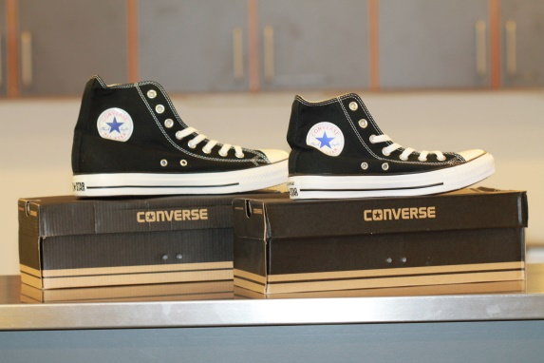
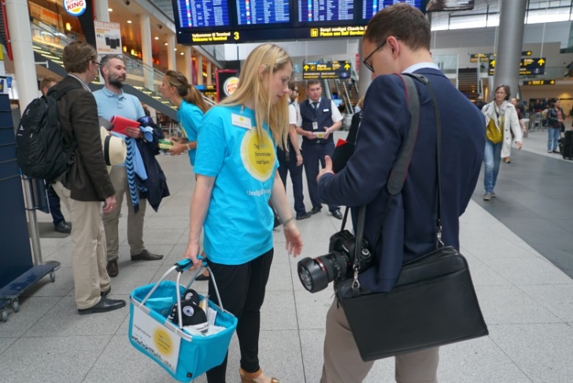

Consumer Awareness Campaign
- on World Anti-Counterfeiting Day, 8 June 2016

Slide 20
Awareness Campaign
Purpose
To inform consumers of the dangers of counterfeit products - and how the can avoid buying them unknowingly
When
8 June 2016 - World Anti-Counterfeiting Day 2016
Slogan
“Bring home REAL holiday memories – Avoid counterfeited products”
Notes:
For the Awareness Campaign considerable resources was spent on preparing a strategy and a communication plan.

Slide 21
Awareness Campaign
Who was behind the campaign?
Danish Ministerial Network against IPR Infringements
The Danish Minister for Business and Growth was involved
Danish Anti Counterfeiting Group (DACG) – Non-profit group
Active participant on the day of the campaign (30 persons):
Danish Customs
State Prosecutor for Serious and International Crime
Danish Medicines Agency
Danish Veterinary and Food Administration
European Consumer Centre Denmark (part of National Competition and Consumer Authority)
Danish Patent and Trademark Office
Danish Anti Counterfeiting Group

Slide 22
Awareness Campaign
Where:
Copenhagen Airport
Copenhagen Central Train Station
Selected Metro Stations
What did we do:
Handed out candy boxes and flyers
Showed samples of genuine vs. fake products
Extensive Media Coverage - a key success criteria in order to spread the campaign message as much as possible

Slide 23
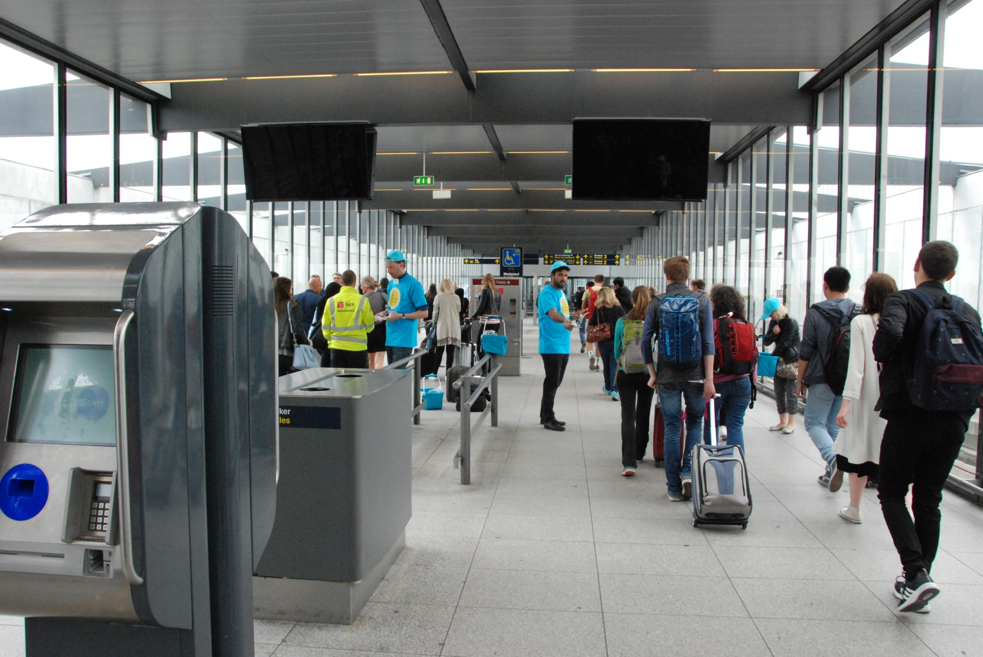
Awareness kampagnen

Slide 24
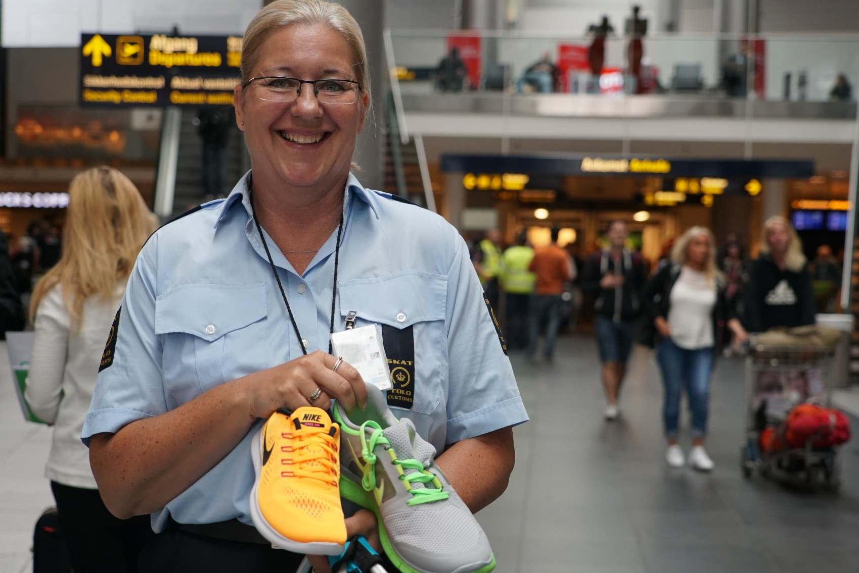

Slide 25
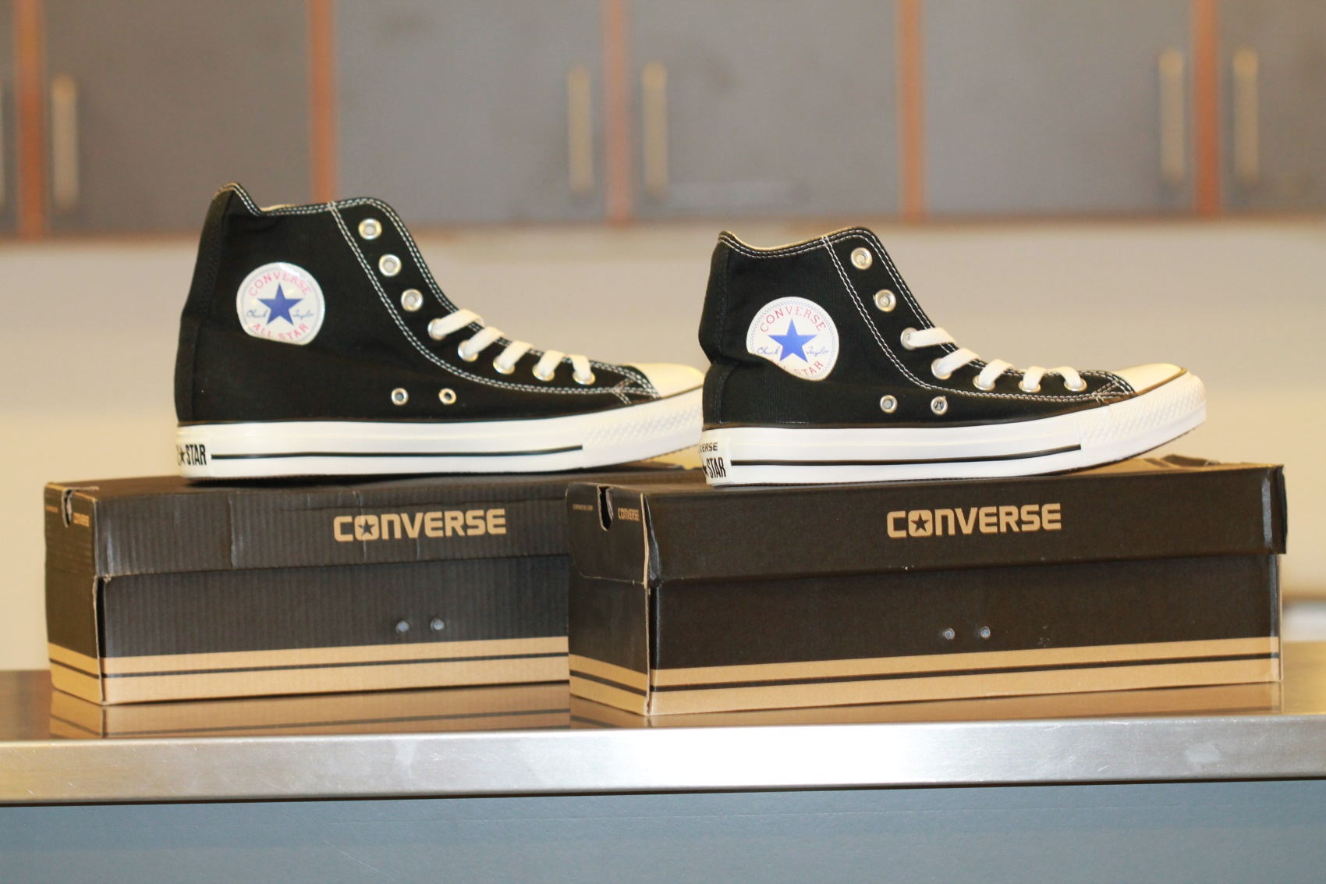
Notes:
The right one is the original

Slide 26

Awareness Campaign
Positive feedback:
Consumers were generally willing to receive the campaign material
Many consumers engaged in dialogues about counterfeit products
Some of the consumers had own “horror stories” about counterfeit products (showing they could relate to the topic)

Slide 27
Awareness Campaign
Other results
Campaign materials distributed during the campaign:
Approx. 9000 brochures and 9000 candy boxes
Remaining campaign material is used for:
Danish Customs
DHL Run (large social yearly running competition)
Anti Counterfeiting Seminar 2016
Copenhagen Culture night (Customs and Ministry of Business and Growth)
Approx. 2200 % more visits to www.stopfakes.dk on the day of the campaign (compared to normal use of the website)
Notes:
Results in form of media coverage
Conclusion: Exceeded all expectations - excellent and broad media coverage!
Summary:
68 times media coverage! (social media is not included in this number)
- some of the campaign staff used all day on media relations
TV, radio, web and printed media – nation-wide, regional and local media:
TV: Coverage in prime time TV news on main channels: (TV-avisen, DR2, DR Ultra for kids)
Radio: P3, P4, Radio24syv (incl. news and “Good morning P3)
Nation-wide newspapers/news platforms: Almost all of them covered the campaign

Slide 28

Awareness Campaign
Financing?
EUIPO financed the Awareness campaign and the new website through its bilateral cooperation agreement with the Danish Patent and Trademark Office

Slide 29
Agenda
Ministerial Network against IPR infringements
Hotline on Counterfeiting

Slide 30


HOTLINE
ON COUNTERFEITING
Get help if your product has been counterfeited
Unit for Enforcement and Anti-counterfeiting

Slide 31
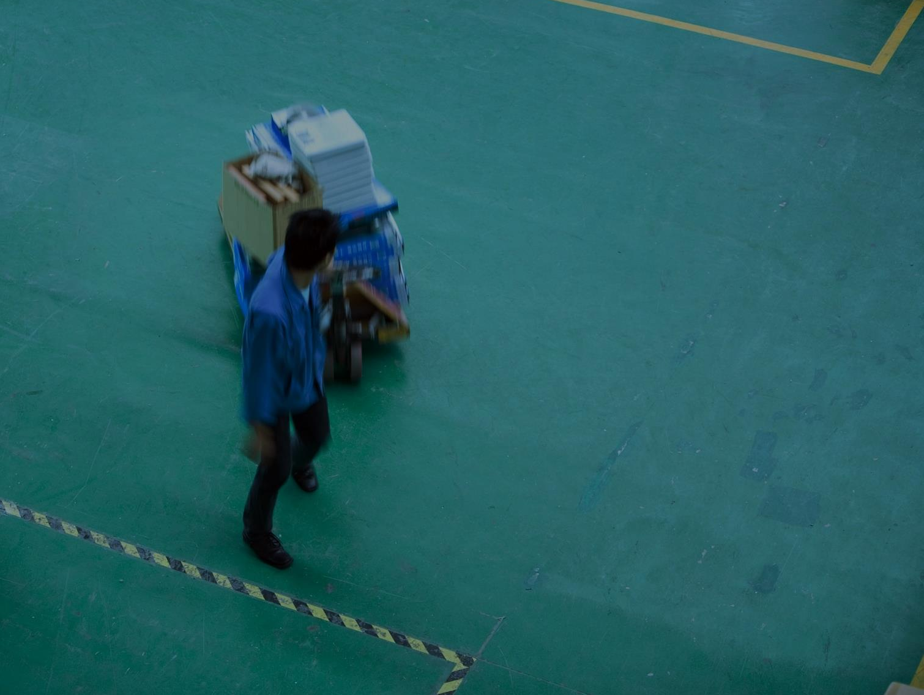
In 2015 Danish Customs detained 51,021 products suspected of being counterfeited
In Denmark businesses loose € 622 million annually due to counterfeiting

Slide 32


3 good reasons to contact
Hotline on Counterfeiting
1
Obtain a better basis for deciding,
if you want to pursue you case
2
Get an overview of your
possible lines of action
3
Get guidance on how to secure your products against counterfeiting

Slide 33

Free guidance
Guidance from Hotline on Counterfeiting
is free of charge.
You may also obtain a written opinion
at the price of DKK 1.500 (approx. EUR 200) .

Slide 34



Contact Hotline on Counterfeiting
Call +45 2260 5687
E-mail to enforce@dkpto.dk
All weekdays between
9.30 – 11.30 a.m.
You are always welcome to send us an e-mail. We will get back to you as soon as possible.

Slide 35

Background
Hotline on Counterfeiting is offered by the Danish Patent and Trademark Office
- Unit for Enforcement and Anti-counterfeiting
Hotline on Counterfeiting provides guidance to small and medium sized businesses
and consumers in specific cases of counterfeiting
Hotline on Counterfeiting provides guidance to all on how to protect their business
Hotline on Counterfeiting provides assistance to the police in their efforts against counterfeiting
Hotline om Counterfeiting was launched 1 January 2017

Slide 36

Hotline on Counterfeiting
Guidance in specific cases:
Advice whether a infringement might have been committed
Suggests possible lines of action:
  - Civil enforcement measures (e.g. through private IP advisers)
  - Criminal enforcement measures
Provide the users with a better basis for deciding:
Whether or not to pursue their case
How to proceed with their case
Assistance on how to report a crime to the police
Notes:
Target users:
Consumers and SMEs
Also assist public authorities – especially police/prosecutors
Price:
Written opinions; fee of EUR 200
Other guidance; free of charge
Launched 1. January 2017 - 25 Cases until now due to careful launching strategy.

Slide 37

Hotline on Counterfeiting
Conditions for guidance in specific cases
Only cases of counterfeiting and piracy
IP rights registered for Denmark (also EU trademarks)
No investigation of the facts of the case
Guidance is non-binding
Verbal guidance or written opinions
Notes:
Only cases of counterfeiting and piracy;
(In cases requiring a complicated legal assessment - in order to determine whether an infringement has been comitted or not - the Enforcement Unit will refer is users to seek guidance from private advisers).
IP rights registered for Denmark (also EU trademarks)
- no assessment of validity of registered rights
No investigation of the facts of the case.
Guidance will be based on information provided by the users and DKPTO’s searches in relevant IP registers
Guidance is non-binding
Verbal guidance or written opinions

Slide 38

Hotline on Counterfeiting
General guidance on infringement and enforcement issues
E.g. legislation, preventive measures etc.
Support to police/prosecutors
Strengthening the already close cooperation
The new enforcement unit gathers DKPTO’s tasks and competencies within enforcement in one unit
(also policy work)

Slide 39

Questions?
Janne Hedegaard (jhw@dkpto.dk)
Principal Project Adviser, International Projects

