Slide 1
Website blocking – a legal and practical overview of practices in the EU and internationally Xenia Iwaszko, LLM Director of International Trade, IFPI Ciudad de México, 12 de Noviembre 2018

Slide 2
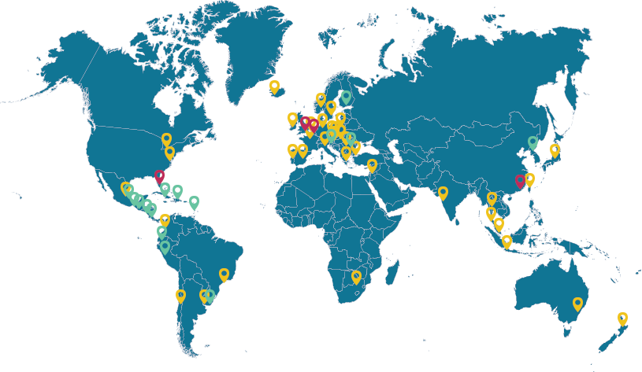
IFPI – representing the recording industry worldwide
Legal and trade policy
Antipiracy operations and litigation
Industry data and market analysis
Communications
Technical standards development
Work with member companies, 59 National Groups and over 75 recording industry Music Licensing Companies (MLCs) to improve protection of recorded music
57
countries with
national organisations
IFPI Offices
1,300
National Groups
Affiliated music licensing company
members worldwide

Slide 3
Music Industry in the Digital Age

Slide 4
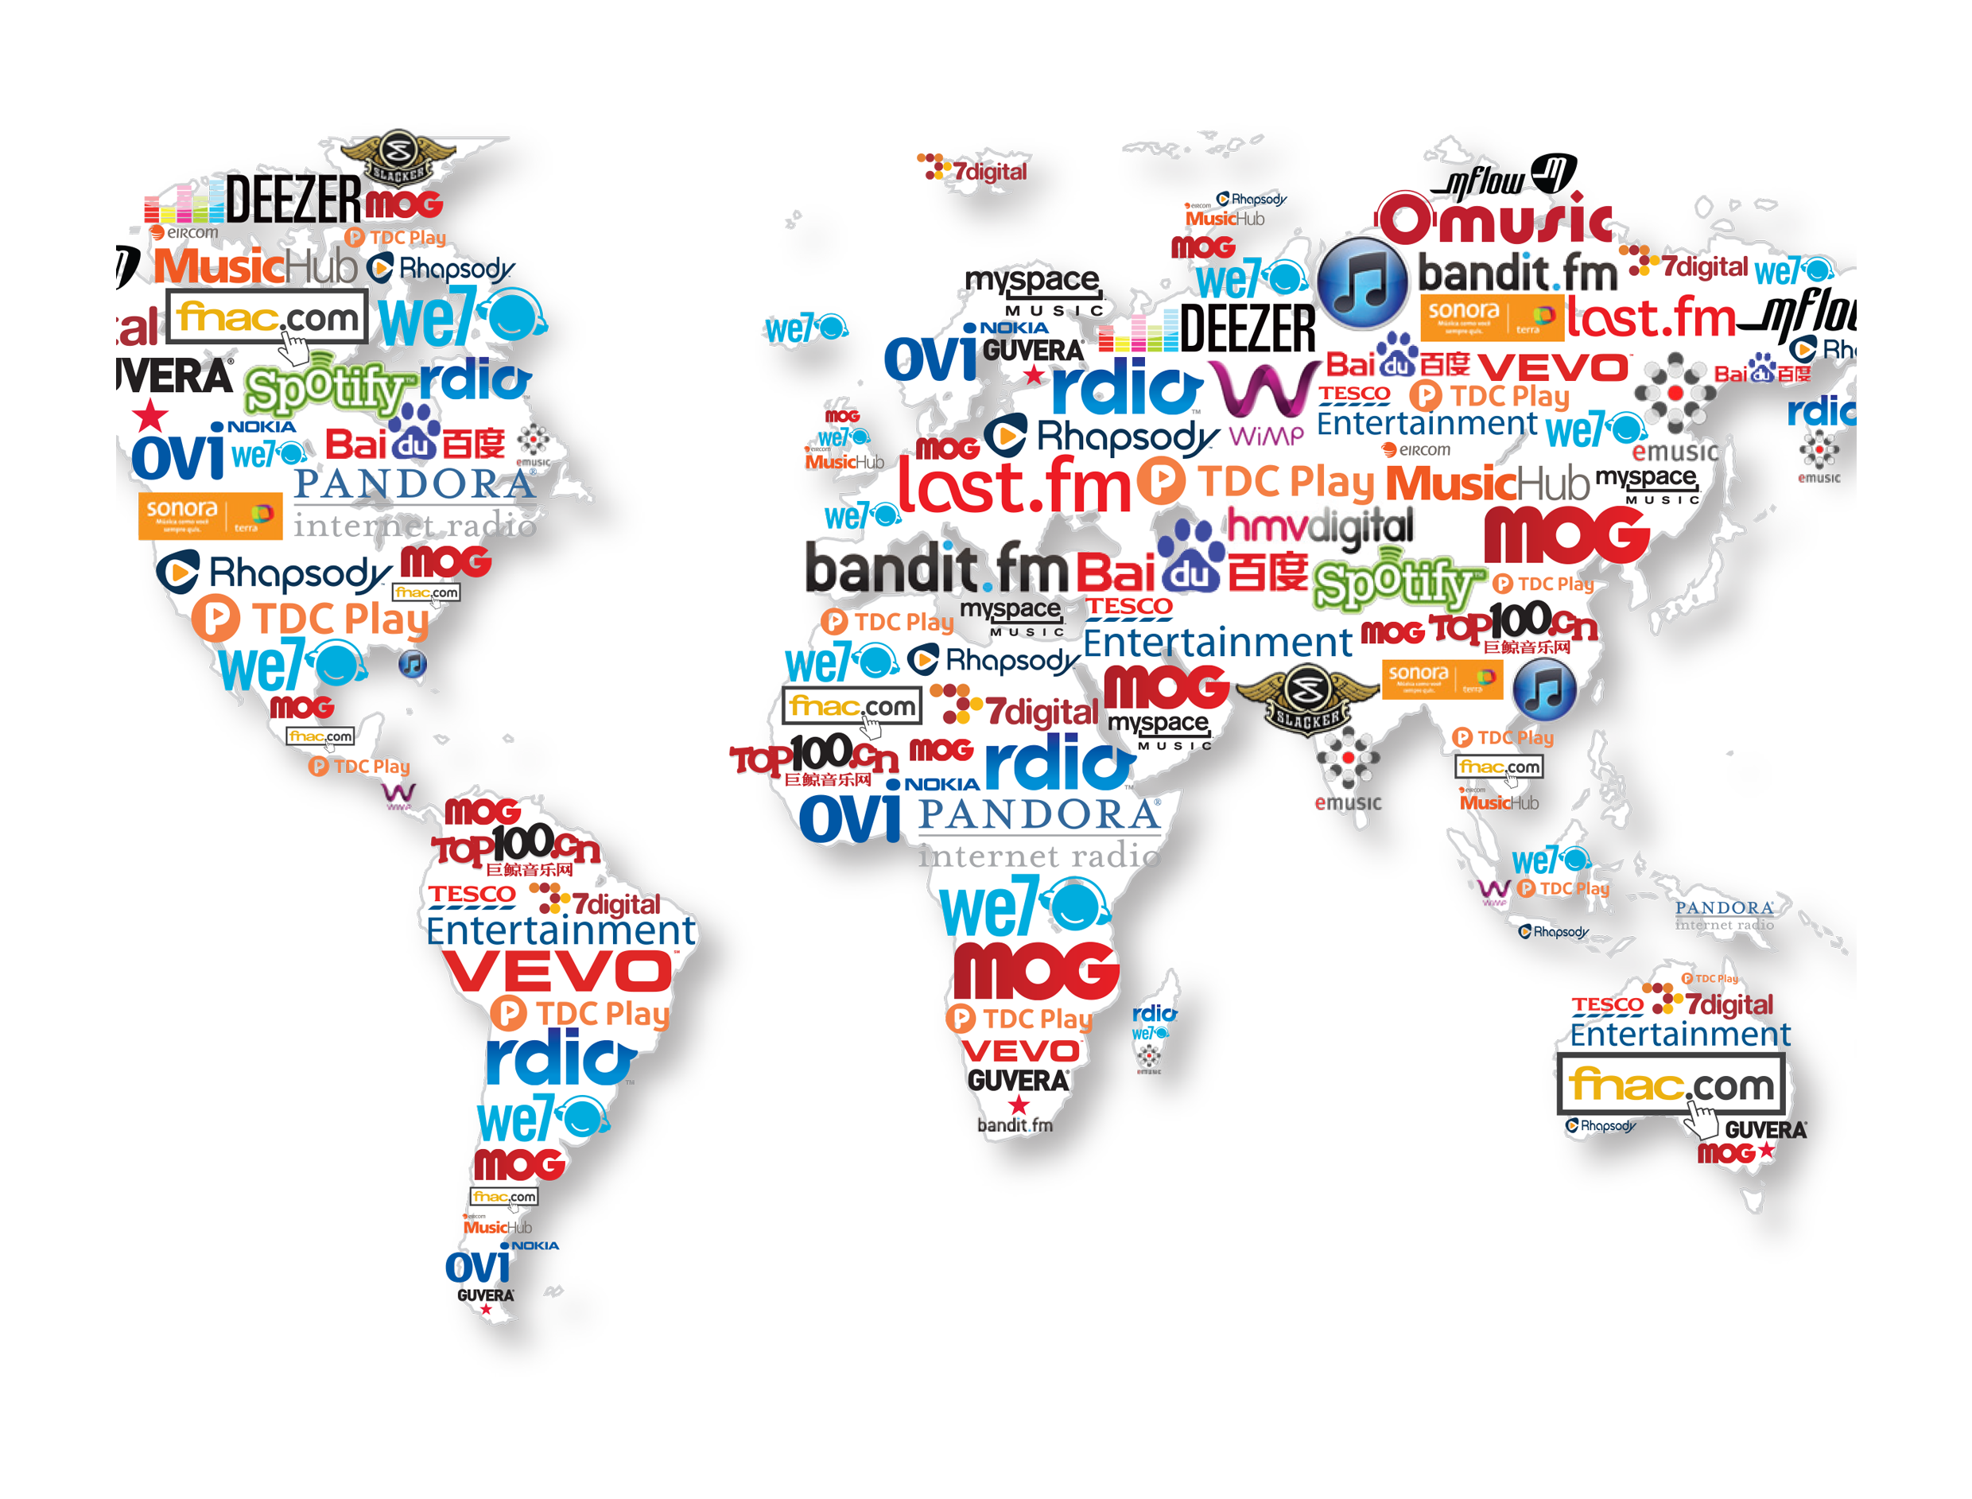
A portfolio business, majority digital
Music anytime, anywhere
Revenue Mix In 2017
Digital accounts for
54%
of total revenues*
Hundreds of digital music services
Millions of venues open to the public
Thousands of TV, radio, cable and satellite broadcasters
And many other licensed business partners
($17.3bn total revenues*)
Physical
Streaming
Performance Rights
Downloads
Synchronisation
Other Digital

Slide 5
Digital piracy is still a major problem…
Unlicensed music is still frequently accessed - access during past 3 months, by territory:
Unlicensed music consumption competes with licensed music
Distortion of competition
License value depression and price depression
Slower conversion rates to paid services
Lower traffic to licensed digital music services
All music creators lose, but producers lose both their past investment and future revenues: piracy breaks the cycle of investment in new music

Slide 6
Website blocking in copyright cases

Slide 7
Website Blocking is an essential tool…
blocking access to copyright infringing websites
implemented by internet access providers = well-positioned intermediaries vis a vis their own customers
an essential tool as direct infringement actions are increasingly difficult for rights holders and law enforcement agencies

Slide 8
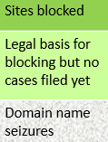
Website Blocking successfully tested in at least 31 countries
AUSTRALASIA AND EURASIA
EU / EEA MEMBER STATES
Australia
Singapore
South Korea
Indonesia
Malaysia
Thailand
India
Russia
Turkey
LATIN AMERICA
Mexico
Brazil
Argentina
Uruguay
Peru
Austria
Belgium
Denmark
Finland
France
Germany
Greece
Iceland
Ireland
Italy
Norway
Netherlands
Portugal
Romania
Sweden
Spain
UK

Slide 9
Website Blocking Procedures

Slide 10
Website Blocking in the EU
EU-level: Article 8.3 Copyright Directive; Article 11 IPR Enforcement Directive
National: specific legal basis in 25 EU Member States
National criminal law: e.g. Belgium and Italy
Administrative procedures: Italy, Spain and Greece
Voluntary Codes of Conduct / MoU with internet access providers: Denmark and Portugal

Slide 11
Website Blocking Outside the EU
Bespoke website blocking legislation providing for orders in civil proceedings, e.g.: Australia, Singapore, Norway
Administrative procedure under specific statute, e.g.: South Korea, Indonesia, Malaysia
Administrative procedure: e.g. Mexico
Judicial procedure in combination with administrative rules: India, Russia
Civil proceedings: e.g. Argentina, Brazil, Uruguay
Other Latin American jurisdictions?

Slide 12
Website Blocking Themes & Challenges
Notes:
IFPI’s insight team recently looked into the impact of blocking in ten countries worldwide
Summary of findings and focus on 3 countries

Slide 13
Website Blocking: A Proportionate Measure
Numerous courts have confirmed blocking is a proportionate measure taken to protect copyright + strikes a fair balance between protecting IP and other fundamental rights
EU-level ruling by the Court of Justice of the EU: C-134/12 UPC Telekabel Wien (Kino.to)
Copyright is a fundamental right that requires a high level of protection
Blocking does not infringe an ISP’s freedom to conduct a business
Injunctions must be strictly targeted to stop copyright infringement but not to deprive users from lawfully accessing information
European Court of Human Rights (Sunde v Sweden [2013]; Ashby v France [2013]):
Dissemination of and access to infringing content deserves less protection than the dissemination of legal information, and therefore
The protection of property can prevail over other fundamental rights
Numerous cases across many jurisdictions follow this approach

Slide 14
Website Blocking: A Tool to Prevent Many Types of Copyright Infringement Online
Which sites can be blocked?
BitTorrent sites typically blocked first & most widely
Linking sites blocked in at least 8 countries
Cyberlockers currently blocked in South Korea and Malaysia
Stream ripping services – a new challenge and case-law is emerging:
Denmark: Convert2mp3 blocked in July 2018
Italy: Emp3a blocked in April 2018 and Freesound in July 2018
Pending actions in other countries
MoU in Denmark covers all types of cases, while the MoU in Portugal covers BitTorrent and Linking sites only

Slide 15
Website Blocking Themes & Challenges
Effectiveness & scope: narrow vs. dynamic injunctions
Cost of implementing website blocks
Procedural issues – speed is of the essence

Slide 16
Impact of Website Blocking
Notes:
IFPI’s insight team recently looked into the impact of blocking in ten countries worldwide
Summary of findings and focus on 3 countries

Slide 17
Website blocking works to lower infringement
66-91% reduction in unique visitors / visits to blocked sites (various studies)
Blocking multiple sites:
reduces overall piracy
reduces use of pirate services within a specific piracy category (e.g. BitTorrent)
leads to increased use of licensed services
reduction occurs quickly and is rarely followed by any subsequent and significant increase
Effectiveness influenced by:
scope: are mirror sites included? are other similar services included?

Slide 18
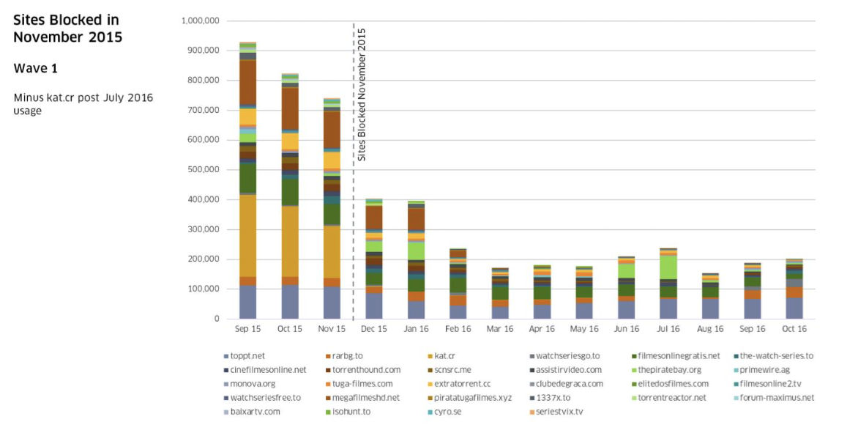
Effectiveness of Website Blocking: Portugal
Blocking Orders:
The Ministry of Culture in Portugal can order ISPs to block sites via DNS. First blocks began in November 2015.
Initial list focused on bittorrent portals and film streaming sites.
Overall popularity fell by 72.8% over the course of one year.
Incopro measured effectiveness using data from Alexa.
Source: Alexa / Incopro

Slide 19
Effectiveness of Website Blocking: UK
Danaher/Smith/Telang
Website Blocking Revisited: The Effect of the UK November 2014 Blocks on Consumer Behaviour
April 2016
90%
6-10%
Drop in visits to blocked sites
Increase in legal services

Slide 20
Gracias! Consultas?

