Slide 1
DEVELOPMENT OF EU LEGISLATION AND CASE LAW ON THE RIGHTS OF COMMUNICATION AND (INTERACTIVE) MAKING AVAILABLE TO THE PUBLIC
Dr. Mihály Ficsor
Member of the Hungarian Copyright Council,
former Assistant Director General of WIPO

Slide 2
Prof. Zheng Chengsi
Prof. Guo Shuokang
In memory and honor of two great figures of Chinese and international IP law, two outstanding scholars, two faithful friends of mine

Slide 3
I. INTERNATIONAL AND EU PROVISIONS ON THE RIGHTS OF COMMUNICATION AND (INTERACTIVE) MAKING AVAILABLE TO THE PUBLIC

Slide 4
Right of making available to the public under the WCT – as part of a broad right of communication to the public
WCT Article 8 [the „umbrella solution]:
Without prejudice to the provisions of Articles 11(1)(ii), 11bis (1)(i) and (ii), 14(1)(ii) and 14bis(1) of the Berne Convention, authors of literary and artistic works shall enjoy the exclusive right of authorizing any communication to the public of their works, by wire or wireless means, including the making available to the public of their works in such a way that members of the public may access these works from a place and at a time individually chosen by them.
Agreed statement concerning Article 8: It is understood that the mere provision of physical facilities for enabling or making a communication does not in itself amount to communication within the meaning of this Treaty or the Berne Convention. (Emphasis added.)

Slide 5
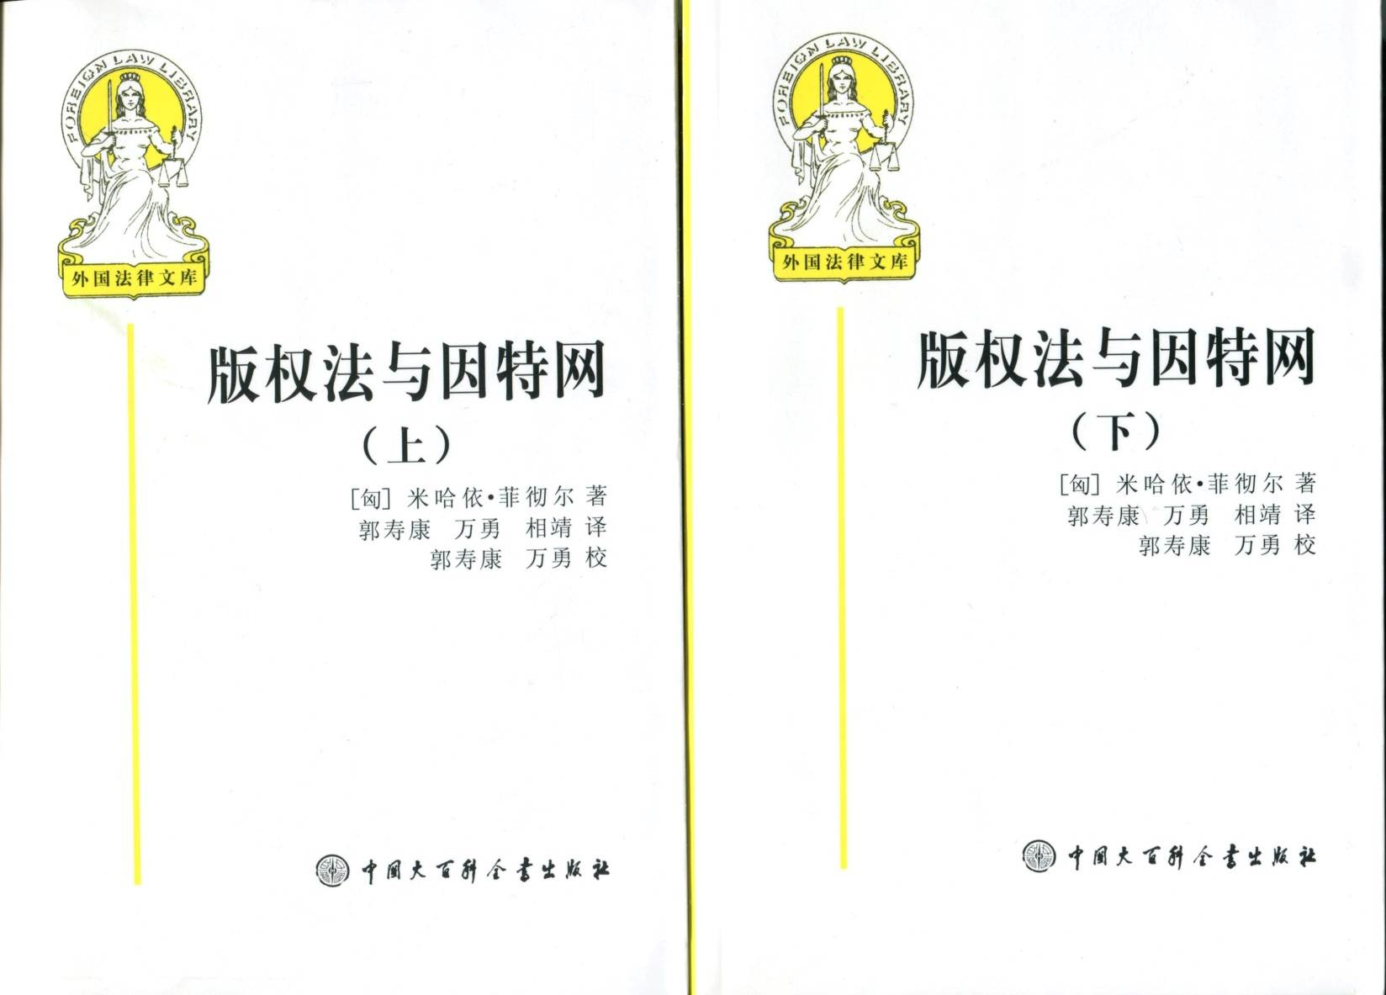
Chinese translation published by Renmin University Press of Dr. Mihály Ficsor’s book „The Law of Copyright and the Internet” originally published by Oxford University Press

Slide 6
Right of making available to the public – under the Information Society Directive
„InfoSoc” Directive Article 3
1. Member States shall provide authors with the exclusive right to authorise or prohibit any communication to the public of their works, by wire or wireless means, including the making available to the public of their works in such a way that members of the public may access them from a place and at a time individually chosen by them.
2. Member States shall provide for the exclusive right to authorise or prohibit the making available to the public, by wire or wireless means, in such a way that members of the public may access them from a place and at a time individually chosen by them:
(a) for performers, of fixations of their performances;
(b) for phonogram producers, of their phonograms;
(c) for the producers of the first fixations of films, of the original and copies of their films;
(d) for broadcasting organisations, of fixations of their broadcasts, whether these broadcasts are transmitted by wire or over the air, including by cable or satellite.
3. The rights referred to in paragraphs 1 and 2 shall not be exhausted by any act of communication to the public or making available to the public as set out in this Article.

Slide 7
II. CJEU CASE LAW: THE „NEW PUBLIC” THEORY AND ITS STEP-BY-STEP CORRECTIONS

Slide 8
Copyright case law of the CJEU; adequate judgments
There are a number of excellent judgments of the Court of Justice of the EU:
Infopaq (C-302/10)
Google Spain (C-131/12)
Innoweb (C-202/12)
UPC Telekabel (C-314/12)
L’Oréal v. eBay (C-324/09)
CISAC (T-442/08)
OSA (C-351/12)
Deckmyn (C-201/13)
Ziggo (C-610/15)
Filmspeeler (C-527/15)

Slide 9
But the introduction of the „new public” theory was not fortunate
However, the introduction of the „new public” theory introduced in the SGAE/Rafael Hotels case (C-306/05) was not fortunate :
Berne Convention: the right of communication to the public is applicable for any new act of communication to the public
CJEU: the right of communication to the public is applicable for any act of communication to a new public.
Why did it happen?

Slide 10
The SGAE – TvCatchup – Svensson tryptich
In SGAE (case C-306/05), the CJEU introduced the „new public” theory contrary to the Berne Convention and the WCT under which there is no such criterion of the right of communication to the public and the right of making available to the public and, by this, it extended the exhaustion of rights in a way that it is not in accordance with the international treaties.
In TvCatchup (case C-607/11 ), the Court tried to correct the „new public” theory through the „special technical means” theory which was not in accordance with the treaties either.
In Svensson (case C-466/12 ), the application of the „new public” theory would have led to the abolishment of the right of making available right for any works which has been uploaded on the Internet; the CJEU tried to avoid this and also to „save the Internet” through inventing the „restricted access” theory – introducing by this a (prohibited) formality of protection.

Slide 11
Berne Convention: no criteria of „new public” in case of retransmissions
Article 11bis (1)(ii) of the Berne Convention: [a]uthors of literary and artistic works shall enjoy the exclusive right of authorizing:… any communication to the public by wire or by rebroadcasting of the broadcast of the work, when this communication is made by an organization other than the original one”; (Emphasis added)
The retransmission or rebroadcasting may be made to the same public; it may be made to a part of the same public only, it may be made to the same public or a part thereof along with a public not covered by the original broadcast), and it may be made truly to a new public. All these cases are covered by Article 11bis(1)(ii) of the Berne Convention.
The right covers any new act of commmunication or retransmission to the public , and not only communication or retransmission to a new public.

Slide 12
„New public” theory – the source
In th SGAE judgmenet (Case C-306/05), the CJEU did not interprete of Article 11bis(1) of the Berne Convention on the basis of its text and negotiation history (the so-called „preparatory work”).
It based its interpretation exclusively on an old out-of-date WIPO Guide published in 1978 as an introductory paper for developing countries – in the Preface of which it was stressed that it had been written in a simple style and was not intended to be a thorough interpretation of the Convention.
Apparently, the judges have not been informed (but they should have been)
that they had misunderstood an example as a definition;
that, if they wanted to base the judgment on WIPO documents, they should have made use of the several resolutions adopted by the competent bodies of the Berne Union after 1978, and
that, if they still wanted to use only the WIPO Guide to the Berne Convention, they should have used the new Guide published in 2003, that is 25 years later.

Slide 13
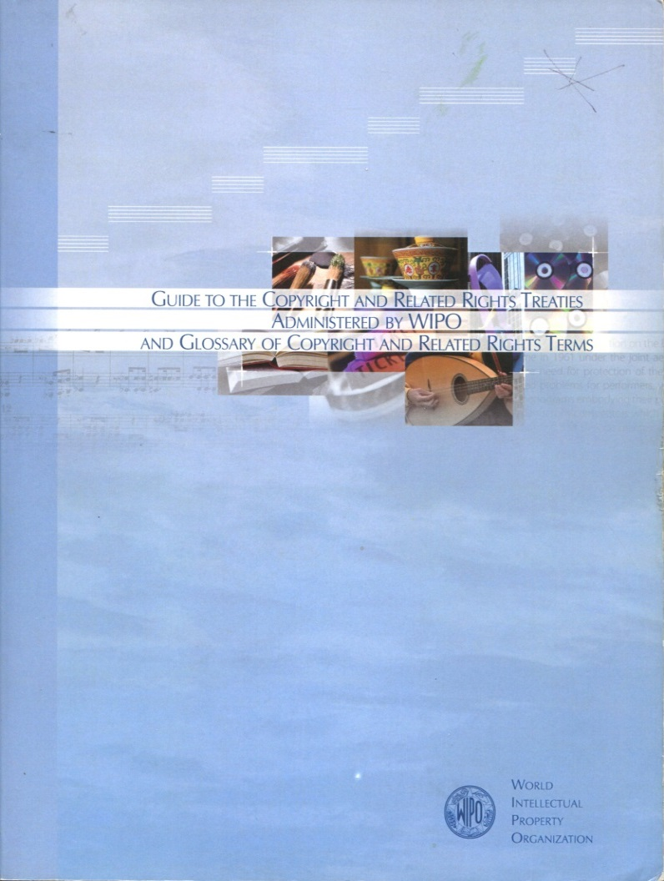
The new WIPO Guide published
in 2003 – not only for developing countries – in which it is made clear that, for the application of the right of communication to the public, there is no need for a „new public.
The Chinese version is available free of charge at
www.wipo.int/edocs/pubdocs/zh/copyright/891/wipo_pub_891.pdf

Slide 14
TvCatchup: honest attempt of correction by the „specific technical means” theory – but in contradiction with the Berne Convention
In its TvCatchup (case C-607/11 ) judgments the CJEU has stated as follows:
The concept of ‘communication to the public’,… must be interpreted as meaning that it covers a retransmission of the works included in a terrestrial television broadcast
– where the retransmission is made by an organisation other than the original broadcaster,
– by means of an internet stream made available to the subscribers of that other organisation who may receive that retransmission by logging on to its server, [„because it is retransmission by another „specific technical means”]
– even though those subscribers are within the area of reception of that terrestrial television broadcast and may lawfully receive the broadcast on a television receiver. [that is, there is no „new public”] (Emphasis added.)
But the Berne Convention makes it clear that retransmission by the same technical means to the same public – that is not necessarily a now one – is equally covered: under Article 11bis(1)(ii), there is an exclusive right of rebroadcasting (which is obviously is mae by the same technical means as broadcasting).

Slide 15
Svensson: honest attempt to „save” both copyright and the Internet – but by introducing a formality
In Svensson (case C-466/12 ), the CJEU has ruled as follows:
Article 3(1) of Directive 2001/29/EC… [on the right of communication – and making available – to the public] on the harmonisation of certain aspects of copyright and related rights in the information society, must be interpreted as meaning that the provision on a website of clickable links to works freely available on another website does not constitute an ‘act of communication to the public’, as referred to in that provision.
In this case, the application of the „new public” and „specific technical means” theories would have led to the abolishment of the making available right. The CJEU tried to avoid this through inventing the „restricted access” theory -- introducing by this a (prohibited) formality of protection and the exhaustion of the right making available (not allowed under the treaties and the acquis.)
As a result, no other business method would have been possible but only making available works with restricted access (the concept of which was not duly clarified).

Slide 16
Corrections in GS Media
In the GS Media case (Case C-160/15), a chamber of the CJEU has made certain corrections in contrast with the previous case law of the Court. The summary of the judgement reads as follows:
Article 3(1) of Directive 2001/29/EC… must be interpreted as meaning that, in order to establish whether the fact of posting, on a website, hyperlinks to protected works, which are freely available on another website without the consent of the copyright holder, constitutes a ‘communication to the public’ within the meaning of that provision, it is to be determined whether those links are provided without the pursuit of financial gain by a person who did not know or could not reasonably have known the illegal nature of the publication of those works on that other website or whether, on the contrary, those links are provided for such a purpose, a situation in which that knowledge must be presumed. (Emphasis added.)

Slide 17
Opening for the application of the of implied license doctrine and innocent infringement defense
In paragraph 42 of the GS Media judgement, the CJEU has indicated the following reason for which the right of communication to the public is not applicable where a rightsholder makes available a work or object of related rights online freely (without restricting access to it): „as soon as and as long as that work is freely available on the website to which the hyperlink allows access, it must be considered that, where the copyright holders of that work have consented to such a communication, they have included all internet users as the public.”
Is there any basis whatsoever for „considering” such consent of the copyright holders where they clearly state the opposite (and not necessarily along with a „paywall”) on their websites (for example – on the basis of their rights of authorization or prohibition – they clearly prohibit the use of their works through other websites for direct or indirect commercial purposes)?
GS Media has raised the possibility of applying the implied license doctrine and the innocent infringement defense („a person who did not know or could not reasonably have known”) – instead of the „new public”, „specific technical means” and „restricted access” theories.

Slide 18
Soulier: chance to replace the „new public” theory with the implied license doctrine (1)
In Soulier (Case C-160/15), the CJEU has quite clairly referred to an implied license basis of its Svensson judgment:
34 . …[S]ubject to the exceptions and limitations laid down exhaustively in Article 5 of Directive 2001/29, any use of a work carried out by a third party without… prior consent must be regarded as infringing the copyright in that work (see, to that effect, judgment of 27 March 2014, UPC Telekabel Wien, C‑314/12, EU:C:2014:192, paragraphs 24 and 25).
35. Nevertheless, Article 2(a) and Article 3(1) of Directive 2001/29 do not specify the way in which the prior consent of the author must be expressed, so that those provisions cannot be interpreted as requiring that such consent must necessarily be expressed explicitly. It must be held, on the contrary, that those provisions also allow that consent to be expressed implicitly. (Emphasis added.)
For the reference to Svensson in this context, see the following slide:

Slide 19
Soulier: chance to replace the „new public” theory with the implied license doctrine (2)
Soulier:
In paragraph 36, the Court has referred to Svensson as an example of the application of implied licenses in this way: “the Court held that, in a situation in which an author had given prior, explicit and unreserved authorisation to the publication of his articles on the website of a newspaper publisher, without making use of technological measures restricting access to those works from other websites, that author could be regarded, in essence, as having authorised the communication of those works to the general internet public.”

Slide 20
Bravo CJEU ! De facto rejection of the „new public” theory in Córdoba
Judgment of the CJEU in Land Nordrhein – Westfalien v. Dirk Renkhoff (case C-161/17) -- adopted in August 2018 (the so-called „Córdoba” case with reference to the topic of the photograph):
The concept of ‘communication to the public’, within the meaning of Article 3(1) of Directive 2001/29/EC of the European Parliament and of the Council of 22 May 2001 on the harmonisation of certain aspects of copyright and related rights in the information society, must be interpreted as meaning that it covers the posting on one website of a photograph previously posted, without any restriction preventing it from being downloaded and with the consent of the copyright holder, on another website.

Slide 21
The CJEU on active (false) intermediaries (1)
Summary of the judgement of the CJEU in the L’Oréal case (Case C-324/09):
6. Article 14(1) of Directive 2000/31/EC of the European Parliament and of the Council of 8 June 2000 on certain legal aspects of information society services, in particular electronic commerce, in the Internal Market (‘Directive on electronic commerce’) must be interpreted as applying to the operator of an online marketplace where that operator has not played an active role allowing it to have knowledge or control of the data stored.
The operator plays such a role when it provides assistance which entails, in particular, optimising the presentation of the offers for sale in question or promoting them.

Slide 22
The CJEU on active (false) intermediaries (2)
L’Oréal (continued)
Where the operator of the online marketplace has not played an active role within the meaning of the preceding paragraph and the service provided falls, as a consequence, within the scope of Article 14(1) of Directive 2000/31, the operator none the less cannot, in a case which may result in an order to pay damages, rely on the exemption from liability provided for in that provision if it was aware of facts or circumstances on the basis of which a diligent economic operator should have realised that the offers for sale in question were unlawful and, in the event of it being so aware, failed to act expeditiously in accordance with Article 14(1)(b) of Directive 2000/31. (Emphasis added.)

Slide 23
The CJEU on active (false) intermediaries (3)
Judgement of the CJEU in the Deepak Mehta case (Case C-521/17):
Articles 12 to 14 of Directive 2000/31/EC … (‘Directive on electronic commerce’) must be interpreted as meaning that the limitations of liability for which they provide apply to the provider of an IP address rental and registration service allowing the anonymous use of internet domain names, such as that at issue in the case in the main proceedings, inasmuch as that service comes within the scope of one of the categories of service referred to in those articles and meets all the corresponding conditions, in so far as the activity of such a service provider is of a merely technical, automatic and passive nature, implying that he has neither knowledge of nor control over the information transmitted or cached by his customers, and in so far as he does not play an active role in allowing those customers to optimise their online sales activity, these being matters for the referring court to verify. (Emphasis added.)

Slide 24
IV. ARTICLE 13 OF THE DRAFT DIGITAL SINGLE MARKET DIRECTIVE ON ACTIVE („FALSE”) INTERMEDIARIES

Slide 25
Article 13 of the Draft Directive (1)
Article 13. Use of protected content by information society service providers storing and giving access to large amounts of works and other subject-matter uploaded by their users
Information society service providers that store and provide to the public access to large amounts of works or other subject-matter uploaded by their users shall, in cooperation with rightholders, take measures to ensure the functioning of agreements concluded with rightholders for the use of their works or other subject-matter or to prevent the availability on their services of works or other subject-matter identified by rightholders through the cooperation with the service providers. Those measures, such as the use of effective content recognition technologies, shall be appropriate and proportionate. The service providers shall provide rightholders with adequate information on the functioning and the deployment of the measures, as well as, when relevant, adequate reporting on the recognition and use of the works and other subject-matter. (Continues)

Slide 26
Article 13 of the Draft Directive (2)
Article 13
2. Member States shall ensure that the service providers referred to in paragraph 1 put in place complaints and redress mechanisms that are available to users in case of disputes over the application of the measures referred to in paragraph 1.
3. Member States shall facilitate, where appropriate, the cooperation between the information society service providers and rightholders through stakeholder dialogues to define best practices, such as appropriate and proportionate content recognition technologies, taking into account, among others, the nature of the services, the availability of the technologies and their effectiveness in light of technological developments.
(Emphasis added.)

Slide 27
New proposal by the European Commission (1)
Article 13. Use of protected content by information society service providers storing and giving access to large amounts of works and other subject-matter uploaded by their users
1. Information society service providers that store and provide to the public access to large amounts of works or other subject-matter uploaded by their users shall, in cooperation with rightholders, take measures to ensure the functioning of agreements concluded with rightholders for the use of their works or other subject-matter or to prevent the availability on their services of works or other subject-matter identified by rightholders through the cooperation with the service providers. Those measures, such as the use of effective content recognition technologies, shall be appropriate and proportionate. The service providers shall provide rightholders with adequate information on the functioning and the deployment of the measures, as well as, when relevant, adequate reporting on the recognition and use of the works and other subject-matter.

Slide 28
New proposal by the European Commission (2)
Article 13 (cont.)
2. Member States shall ensure that the service providers referred to in paragraph 1 put in place complaints and redress mechanisms that are available to users in case of disputes over the application of the measures referred to in paragraph 1.
3. Member States shall facilitate, where appropriate, the cooperation between the information society service providers and rightholders through stakeholder dialogues to define best practices, such as appropriate and proportionate content recognition technologies, taking into account, among others, the nature of the services, the availability of the technologies and their effectiveness in light of technological developments.

Slide 29
Draft amendments adopted by the European Parliament (1)
Article 13. Use of protected content by online content sharing service providers storing and giving access to large amounts of works and other subject-matter uploaded by their users
1. Without prejudice to Article 3(1) and (2) of Directive 2001/29/EC, online content sharing service providers perform an act of communication to the public. They shall therefore conclude fair and appropriate licensing agreements with right holders.
2. Licensing agreements which are concluded by online content sharing service providers with right holders for the acts of communication referred to in paragraph 1, shall cover the liability for works uploaded by the users of such online content sharing services in line with the terms and conditions set out in the licensing agreement, provided that such users do not act for commercial purposes.

Slide 30
Draft amendments adopted by the European Parliament (2)
Article 13 (cont.)
2a. Member States shall provide that where right holders do not wish to conclude licensing agreements, online content sharing service providers and right holders shall cooperate in good faith in order to ensure that unauthorised protected works or other subject matter are not available on their services.
Cooperation between online content service providers and right holders shall not lead to preventing the availability of non-infringing works or other protected subject matter, including those covered by an exception or limitation to copyright.

Slide 31
Draft amendments adopted by the European Parliament (3)
Article 13 (cont.)
2b. Members States shall ensure that online content sharing service providers referred to in paragraph 1 put in place effective and expeditious complaints and redress mechanisms that are available to users in case the cooperation referred to in paragraph 2a leads to unjustified removals of their content. Any complaint filed under such mechanisms shall be processed without undue delay and be subject to human review. Right holders shall reasonably justify their decisions to avoid arbitrary dismissal of complaints. Moreover, in accordance with Directive 95/46/EC, Directive 2002/58/EC and the General Data Protection Regulation, the cooperation shall not lead to any identification of individual users nor the processing of their personal data. Member States shall also ensure that users have access to an independent body for the resolution of disputes as well as to a court or another relevant judicial authority to assert the use of an exception or limitation to copyright rules.

Slide 32
Draft amendments adopted by the European Parliament (4)
Article 13 (cont.)
3. As of [date of entry into force of this directive], the Commission and the Member States shall organise dialogues between stakeholders to harmonise and to define best practices and issue guidance to ensure the functioning of licensing agreements and on cooperation between online content sharing service providers and right holders for the use of their works or other subject matter within the meaning of this Directive. When defining best practices, special account shall be taken of fundamental rights, the use of exceptions and limitations as well as ensuring that the burden on SMEs remains appropriate and that automated blocking of content is avoided.

Slide 33
Draft amendments adopted by the European Parliament (5)
Article 13a
Member States shall provide that disputes between successors in title and information society services regarding the application of Article 13(1) may be subject to an alternative dispute resolution system.
Member States shall establish or designate an impartial body with the necessary expertise, with the aim of helping the parties to settle their disputes under this system.
The Member States shall inform the Commission of the establishment of this body no later than (date mentioned in Article 21(1)).

Slide 34
Draft amendments adopted by the European Parliament (6)
Article 13b. Use of protected content by information society services providing automated image referencing
Member States shall ensure that information society service providers that automatically reproduce or refer to significant amounts of copyright- protected visual works and make them available to the public for the purpose of indexing and referencing conclude fair and balanced licensing agreements with any requesting rightholders in order to ensure their fair remuneration. Such remuneration may be managed by the collective management organisation of the rightholders concerned.

Slide 35
THANK YOU
非常感谢
E-mail: ceeca@online.hu
Website: www.copyrightseesaw.net

