Slide 1
The European Patent Office 欧洲专利局
The EPO, a reliable partner for the Chinese users.
欧洲专利局——中国用户的可靠伙伴
The efficient use of the procedural options in Europe
欧洲程序选项的高效利用
Hubert Plugge
休伯特·普拉奇
Director – Applied Physics
应用物理总监
Plugge, Hubert休伯特·普拉奇
European Patent Office欧洲专利局
November 2016 2016年11月

Slide 2
Contents目录
About the European Patent Office欧洲专利局简介
Quality patents高质量专利
Obtaining a European patent获得欧洲专利
Global Dossier/ File inspection/ Patent Register全球案卷/文件查阅/专利注册
Early Certainty早期确定性
How to accelerate procedures at the EPO 如何在欧洲专利局的提高程序效率
The Unitary Patent单一专利
Practical tips for filing实用的提交技巧
Statistics统计
Contact information联系信息
Notes:
2

Slide 3
Our mission我们的使命
As the patent office for Europe, we support innovation, competitiveness and economic growth across Europe through a commitment to high quality and efficient services delivered under the European Patent Convention.作为欧洲的专利局，我们致力于按照《欧洲专利公约》提供优质而高效的服务，从而为整个欧洲的创新、竞争力和经济增长提供支持。

Slide 4
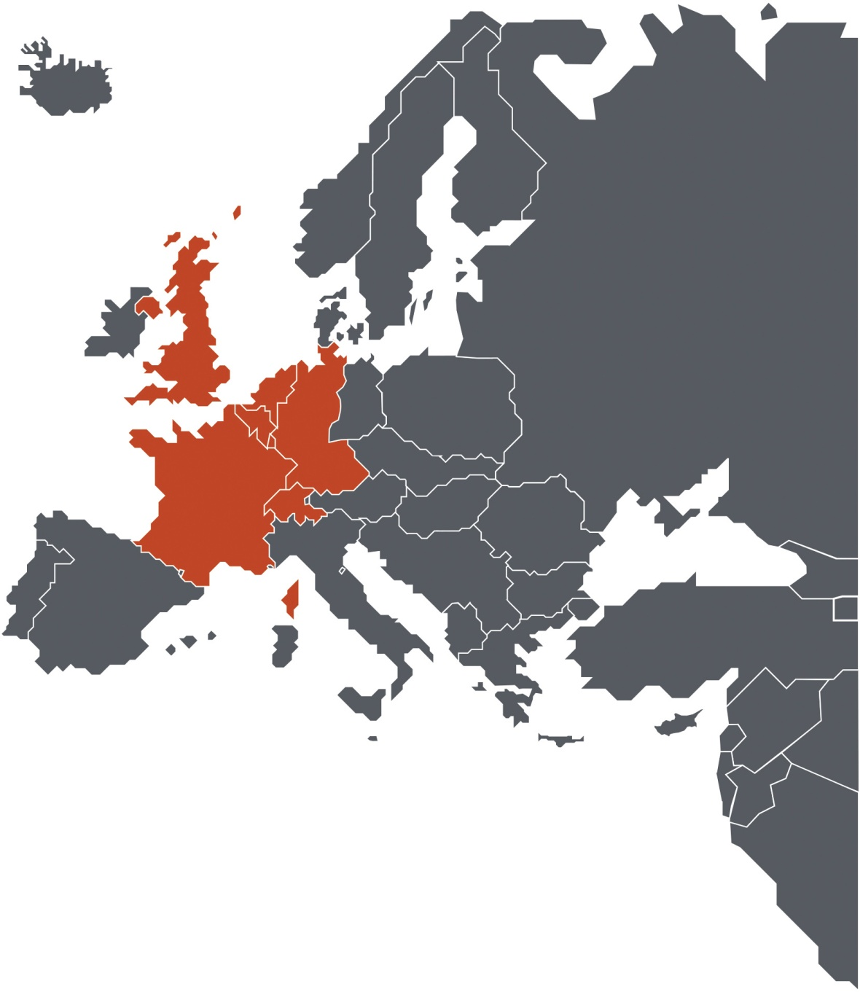
1973 Diplomatic Conference in Munich
1973年慕尼黑外交会议
The European Patent Convention signed by 16 countries 16个国家签署的《欧洲专利公约》
Seven founding states in 1977 1977年的七个创始国
Belgium比利时 • Germany德国 • France法国
Luxembourg卢森堡 • Netherlands荷兰
Switzerland瑞士 • United Kingdom英国

Slide 5
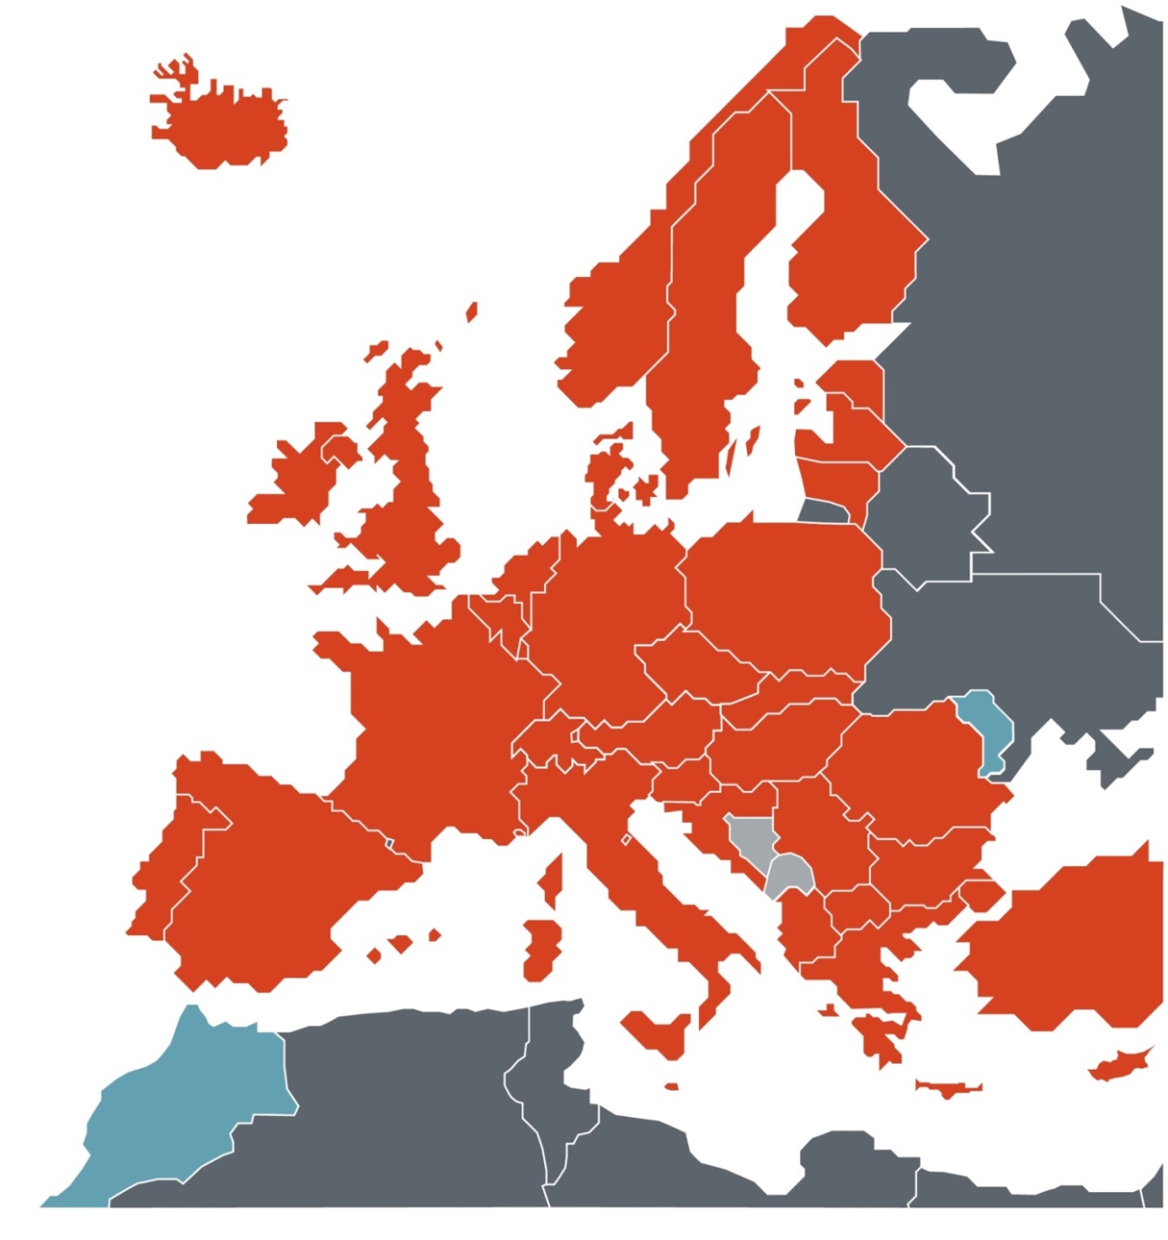
2016 - Patent protection in up to 42 countries
2016年——在多达42个国家提供专利保护
European Patent Organisation欧洲专利组织 Independent organisation, dedicated to patents 专注于专利事务的独立组织
Annual budget:年度预算：2.15 billion € (self-financed) 21.5亿欧元（自筹资金） Member States – almost 700 million成员国人数——近7亿
inhabitants居民
European member states (38)欧洲成员国（38个）
- of which 28 EU member states其中28个为欧盟成员国
2 European extension states 2个为欧洲延伸国 Bosnia-Herzegovina波斯尼亚―黑塞哥维亚（波黑） Montenegro蒙特尼哥罗（黑山）
2 Validation states 2个验证国 Morocco 2015摩洛哥（2015年） Moldova 2015摩尔多瓦（2015年） (+Tunisia – 2016 (TBC))
【+突尼斯（2016年，待确认）】
Population:人口：
~ 700 million~7亿

Slide 6
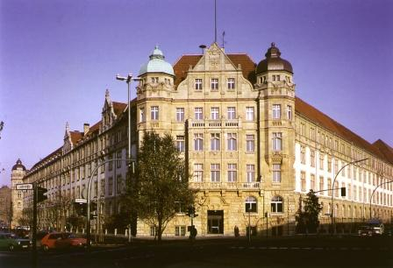
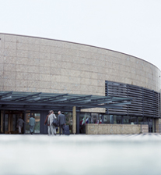
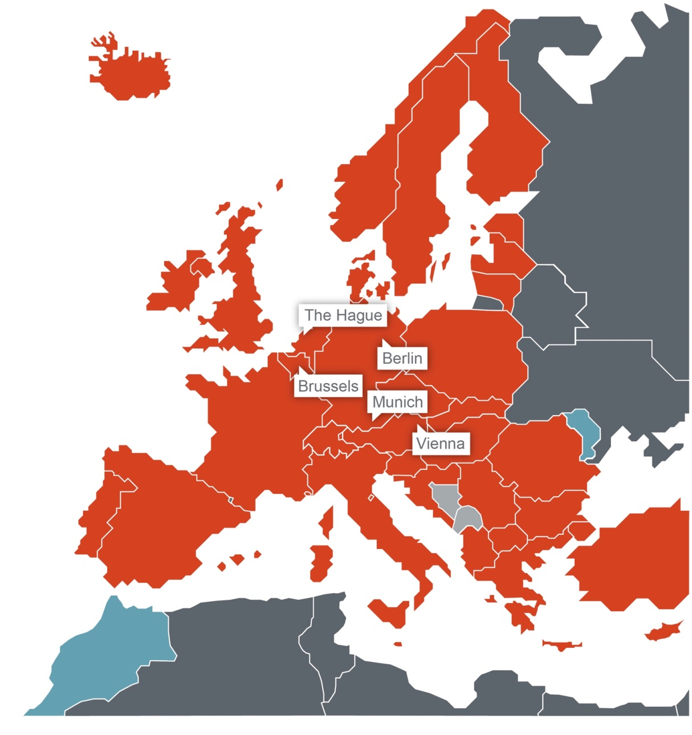
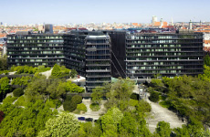
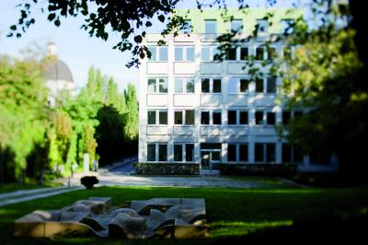
Our five locations in Europe我们在欧洲的五个办公地点
Headquarters总部
Liaison office
with the EU
欧盟联络办

Slide 7
Our staff我们的员工
Munich慕尼黑
3 784人
The Hague海牙
2 659人
Berlin柏林
266人
Vienna维也纳
102人
Brussels布鲁塞尔
4人
Total总计
6 815人
Around 60% are patent examiners
约60%为专利审查员
Source:来源：EPO data on 31.12.2015 2015年12月31日的欧洲专利局数据

Slide 8
Why file with the EPO?
为什么向欧洲专利局提交专利申请？
Geographic region covered by the contracting states: almost 700 million consumers缔约国覆盖的地理区域：近7亿消费者
EPC main achievements:欧洲专利局的主要成就：
A central efficient patent granting authority for Europe欧洲主要、高效的专利授予机构
Granting robust patents in Europe在欧洲授予大量专利
High quality search reports basis for decision in examination优质检索报告可用作审查决定的依据
A single definition of the scope of protection in all designated countries在所有指定国，保护范围的定义均是统一的
2013: 2013年：40th Anniversary of EPC《欧洲专利公约》40周年
2015: 2015年：160,000 applications for a European Patent received2015年收到16万份欧洲专利申请

Slide 9
Quality – a core value of the EPO
质量——欧洲专利局的核心价值
ISO 9001 certification for entire patent granting process整个专利授予流程通过ISO 9001认证
First of the largest patent offices to be fully ISO certified第一个完全通过ISO认证的最大专利局
2016 IAM survey ranked EPO as the best of the five largest patent offices for quality. 2016年，《IAM调查》将欧洲专利局评为五大专利局中的质量最佳专利局
Fifth consecutive IAM survey in which EPO has ranked number 1 for Quality of Products and Services欧洲专利局已经连续五年在IAM的调查中在“产品和服务质量”方面排名第一
ISO 9001 certification ISO 9001认证
in 2014 2014年
ISO 9001 certification ISO 9001认证
in 2015 2015年
+
Patent granting process专利授予流程
Patent information +专利信息+
Post grant activities授予后活动

Slide 10
EPO’s commitment to quality
欧洲专利局注重质量
Users rank EPO no 1 in quality –why? 用户将欧洲专利局排为质量第一的专利局——为什么？
Because, our ISO9001 compliant Quality Management System is in place:因为我们执行符合ISO 9001的质量管理体系
We have a clear and consistent quality policy.我们有明确而始终如一的质量政策。
Our annual quality objectives are broken down to individual level.我们的年度质量目标分解到各个层次。
We invest into high specialisation and intense training of EPO examiners and we do not outsource any core tasks.我们为欧洲专利局审查员的高度专业和强化培训投入资金，我们不外包任何核心任务。
Our state-of-the-art tools allow efficient access by examiners.凭借我们的最先进技术的工具，审查员可高效地访问相关文件。
(e.g. machine translation, the largest documentation set, classification)（这些工具包括机器翻译、最大的文档集、分类等等）
We have a very comprehensive prior art coverage:非常全面的现有技术覆盖面：91 million documents available to examiners. 9,100万份文件可供审查员查阅。
We are involved in international co-operation projects to improve the patent system.我们参与国际合作项目以完善专利制度。

Slide 11
Examination审查
Applications are examined by a panel of three expert examiners.专利申请由三位专家审查员组成的小组审查。
The examiners check that the scope of protection is limited to what is actually patentable.审查员对保护范围限于实际可获得专利权的部分进行审查。
They take into account the search report and the requirements for patentability of the EPC.审查员将检索报告和《欧洲专利公约》对可获得专利性的要求考虑在内。

Slide 12
Asian prior art亚洲现有技术
EPO databases cover nearly 100% of major Asian countries (bibliographic and image data – 40 million documents)欧洲专利局的数据库涵盖亚洲的几乎所有主要国家（书目和图片数据——4千万份文件）
20 million full-text documents – machine-translated into English 2前万份完整文本的文件——机器翻译成英语
Patent Translate:专利翻译：
partnership between the EPO and Google™欧洲专利局与谷歌™合作推出
machine translation service “trained” to handle elaborate patent vocabulary and grammar“经训练的”机器翻译服务以处理复杂的专利词汇和语法
Provides translations from and into English, French and German for a total of 29 different languages (including Chinese, Japanese and Korean)提供共计29种不同语言（包括汉语、日语和韩语）与英语、法语和德语之间的互译

Slide 13
Origin of European patent applications in 2015
2015年欧洲专利申请的来源
Others其他 5%
P.R.China中国 4%
S. Korea韩国 4%
Germany德国 16%
Japan日本 13%
France法国 7%
EPO member states欧洲专利局成员国 47%
Netherlands荷兰 4%
Switzerland瑞士 4%
United Kingdom英国 3%
Italy意大利 2%
United States美国
27%
Sweden瑞典 2%
Other EPO member states
欧洲专利局其他成员国 8%

Slide 14
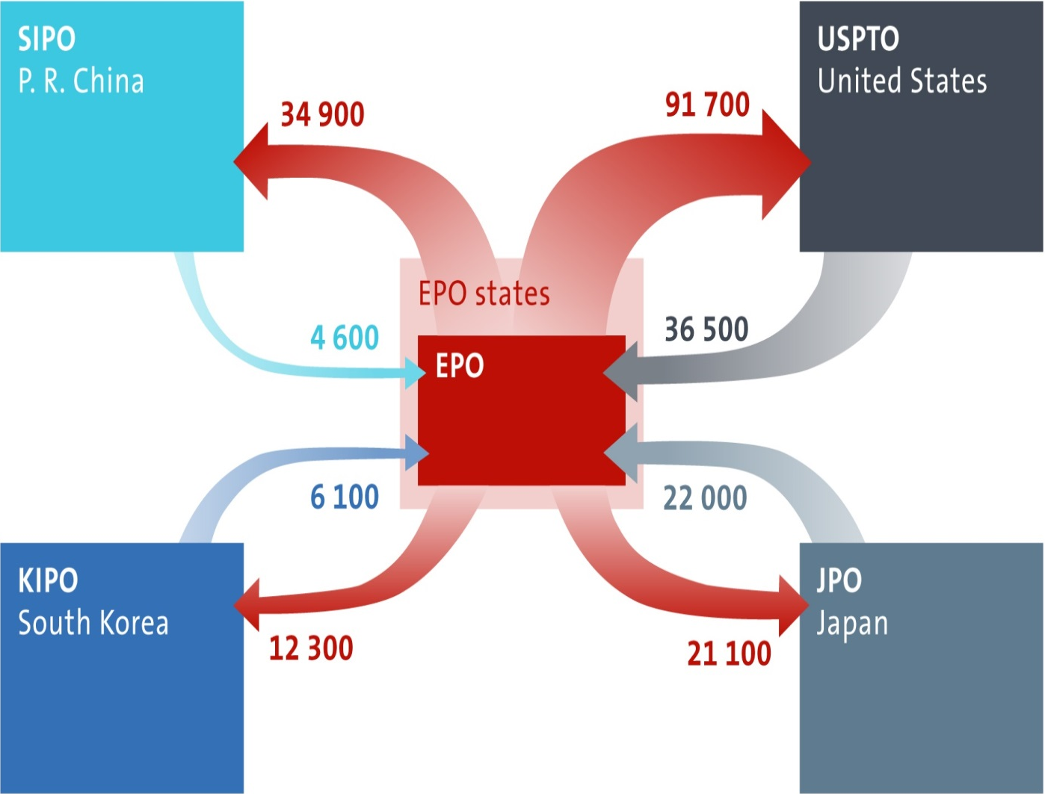
Flow of patent applications between EPO and IP5 countries (2014)
欧洲专利局与世界五大知识产权局之间的专利申请流程（2014年）
中华人民共和国
国家知识产权局
美国专利和商标局
欧洲专利局成员国
欧洲专利局
韩国知识产权局
日本专利局

Slide 15
Options for obtaining a European patent
获得欧洲专利的途径
European route欧洲途径
Applicant files a direct European application
申请人提交直接欧洲申请
= 1st filing第一次提交
European
search and
examination
Procedure
欧洲检索和审查程序
National route国家途径
Applicant files a
national application
申请人提交国家申请
Applicant files a
European application
申请人提交欧洲申请
= 2nd filing第二次提交
Grant
授予
(or Refusal)
（或拒绝）
International route国际途径
Applicant files a
PCT application
申请人提交《专利合作条约》
(PCT)项下的申请
Application enters European phase
申请进入欧洲阶段

Slide 16
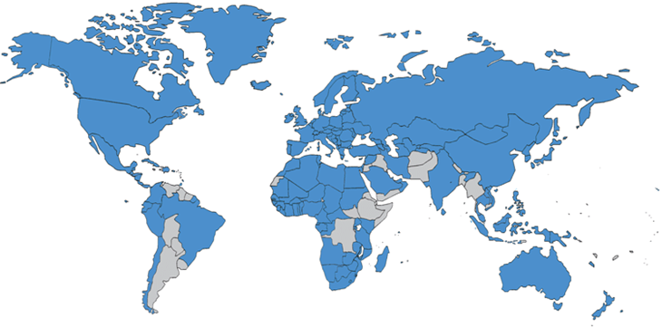
The Patent Cooperation Treaty (PCT)
专利合作条约(PCT)
The PCT is the main tool for applicants seeking patent protection for their inventions in multiple countries《专利合作条约》是专利申请人在多个国家为其发明寻求专利保护的主要途径
More than 218.000 PCT applications filed worldwide in 2015 2015年全世界提交了逾21.8万份PCT申请
More than 21% of PCT filings come from EPC countries来自《欧洲专利公约》国家的PCT提交占21%以上
EPC,《欧洲专利公约》 21%
Rep.KOREA,韩国 6,1%
USA,美国 28,6%
CHINA,中国 11,9%
JAPAN,日本 19,7%

Slide 17
The EPO processes international (PCT) applications
欧洲专利局处理国际PCT申请
The EPO acts as a receiving office for international applications (PCT)欧洲专利局接收国际PCT申请
The EPO carries out approximately:欧洲专利局实施：
38% of all international search procedures大约38%的国际PCT申请需经历所有国际检索程序
58% of all international preliminary examinations大约58%的国际PCT申请需经历所有国际初步审查
The EPO delivers the international search report within 3 months*欧洲专利局在3个月内交付国际检索报告*
* From the date of receipt of the application by the International Searching Authority.从国际检索单位收到申请之日算起。

Slide 18
The EPO and the PCT: a long standing relationship
欧洲专利局和《专利合作条约》：长期关系
PCT has always been a big and still growing part of EPO’s work.《专利合作条约》(PCT)项下的申请一直是欧洲专利局的一大工作而且还在增加。
Currently 2 out of 5 search files at the EPO are PCT files.目前欧洲专利局40%的检索文件是PCT文件。
PCT files are treated exactly like EP files, both for quality and level of service.在质量方面和服务水平方面，欧洲专利局均像对待欧洲专利文件那样对待PCT文件。
The EPO has always promoted the PCT and has a strong interest in continuously improving PCT procedures.欧洲专利局一直在推广PCT并有不断完善PCT程序的强烈意愿。
欧洲-PCT 条款
欧洲专利
专利合作条约(PCT)
国家+其他

Slide 19
Reasons to use the PCT
使用PCT的原因
Strategic decisions 战略决策
solid basis to take informed decisions on national phase entries做出进入国家阶段方面明智决定的坚实基础
AND和
opportunities to amend BEFORE incurring the costs of entering the national phases在产生进入国家阶段的成本之前的修改机会
Time gain – before taking a costly decision on global protection (31 months)在做出代价较高的全球保护决定之前赢得时间（31个月）
Cost and administrative efficiency:成本和行政效率：ONE procedure in ONE language with ONE attorney, ONE search during the PCT international phase在PCT国际阶段仅需一次程序一种语言一位律师一次检索
All-designation system (=automatic designation of all PCT contracting states)所有指定体系（=自动指定《专利合作条约》的所有缔约国）

Slide 20
The Benefits of the PCT Procedure
《专利合作条约》程序的益处
150 contracting parties (September 2016) 150个缔约国（2016年9月）
One international application in one language under the PCT, instead of as many national filings in many different languages按照《专利合作条约》以一种语言提交一次国际申请，无须以多种语言在多个国家提交申请
The international application is filed in a single place, generally the national Patent Office of the applicant’s country.国际申请提交至一个机构，通常为申请人所在国家的国家专利局。
The standard form for an international application is accepted by all designated Offices for the purpose of the national phase.国家阶段的所有指定专利局均接受国际申请的标准格式。
Fees can be paid at one time, at one Office in one currency费用可在一个专利局以一种货币一次性支付
The PCT allows for more time to decide before expanding protection to different countries. PCT的申请人有更多时间来决定是否将专利保护扩展到不同国家。

Slide 21
Supplementary International Search补充国际检索
(General remarks)（一般注解）
At the option of the applicant: second search (with another Office, potentially in another language);根据申请人的选择：第二次检索（由另一专利局检索，可能以另一种语言检索）；
Irrespective of the previous ISA chosen;不受之前选择的国际检索单位影响；
Further reduces the risk of new prior art being cited in the national phase (it includes all documentation that the Authority specified for supplementary search would search in its role as national or regional Office); 进一步降低新的现有技术（包括为补充检索而规定的检索单位作为国家或地区专利局将检索的所有文档）在国家阶段被引用的风险；
Gives more legal certainty before incurring the costs of entering the national/ regional phases在产生进入国家/地区阶段的成本之前给予更多法律确定性

Slide 22
Supplementary International Search at the EPO European Patent Office欧洲专利局作为补充国际检索单位
Advantages (1) 优点（一）:
Given the language knowledge (English, German, French), the SISR established by the EPO helps to overcome problems posed by the linguistic diversity of the prior art that may be found in the national phase;
鉴于European Patent Office欧洲专利局的语言范围（英语、德语、法语），由欧专局提供的补充国际检索报告帮助申请人避免在国家阶段发现新的现有技术的可能性；
Same quality of search, fee and advantages as for EPO’s international search e.g. dispensation of supplementary European search in EP phase;
与欧专局作为主国检索单位进行国际检索相比之下，由欧专局进行的补充国际检索提供一模一样的高质量检索、费用及其他好处。除此之外，如果该补充检索报告是由欧专局作为补充国际单位来出具，那么该补充检索报告将直接被欧专局作为欧洲检索报告使用，而不再出具一份欧洲补充检索报告；

Slide 23
Supplementary International Search at the EPO European Patent Office欧洲专利局作为补充国际检索单位
Advantages (2) 优点（二）:
Because the SIS by EPO is of the same scope and high quality as the international search in EP phase, SISR established by EPO is respected by national offices upon entry into the national phase;
因为由欧洲专利局作为补充国际单位提供补充国际检索报告的规模和质量与由欧专局当一件PCT国际申请进入欧洲时作出的欧洲补充检索报告的规模和质量一致，所以当该申请进入国家阶段时，该补充国际检索报告被国家专利局使用；
Explanations provided by EPO in an annex to the SISR are equivalent to the information contained in a written opinion established by EPO as ISA;
同样，由欧洲专利局在补充国际检索报告附件里提供的解释相当于由欧洲专利局作为主国检索单位在作出书面意见里提供的信息；

Slide 24
Supplementary International Search at the EPO
European Patent Office欧洲专利局作为补充国际检索单位
Advantages (3) 优点（三）:
Applicants may be represented before the EPO as SISA by the agent appointed for the international phase.Thus, Chinese applicants can continue to be represented by the Chinese agent appointed on filing the international application;
在欧专局作为补充国际检索单的过程中，申请人可以委托有权在受理局执行业务的人为其代理人。因此，对于中国申请人而言，其可以继续委托在提交国际申请时委托的中国代理人作为申请人在欧专局作为补充国际检索单位过程中的代表。

Slide 25
Supplementary International Search at the EPO
European Patent Office欧洲专利局作为补充国际检索单位
Requirements for filing a SIS request 申请补充检索的要求:
A request must be filed with the IB within 19 months from the priority date.At the same time the supplementary search handling fee must be validly paid;
申请人须于自优先权日起19个月内向国际局提出补充检索请求并缴纳费用；
Establishment of the SISR 补充国际检索报告的发表:
SISR is established within 28 months within priority date.Therefore, it may improve the basis for deciding on national or European phase entry.
补充国际检索单位应不迟于优先权日起28个月内作出补充国际检索报告。因此，帮助申请人更好地利用该报告作出进入国家阶段或者欧洲阶段的决定。

Slide 26
EPO as designated Office
European Patent Office欧洲专利局作为指定局
In 2015 almost 100.000 applications entered the European phase at the EPO (61,4% of total applications before the EPO);
2015年，在欧洲专利局有将近十万件申请进入过欧洲阶段 （申请总数之61，4%）；
Only way to protect an invention via the PCT in 12 EPC contracting states which have closed their national route;
对于PCT申请而言，十二个欧洲国家已经‘关闭’了其国家渠道。因此，唯一使申请人获得在这十二个国家专利保护的渠道，就是PCT通过向欧洲专利局申请欧洲专利；
Early processing on request;
根据要求进行早期处理；

Slide 27
EPO as Designated Office
European Patent Office欧洲专利局作为指定局
Recognition of EPO’s own earlier work products:
Dispense of search (no supplementary search fee) when EPO=SISA;
Examination Fee reduction (50%) when EPO=IPEA;
认可欧洲专利局已经进行的‘‘工作产品’’：
欧洲专利局作为补充国际检索单位的时不再出具一份欧洲补充检索报告；
欧洲专利局作为国际初步审查单位的时=审查费用减缓 （50%）；
Timeliness: more than 94% (Q1-Q2 2016) of PCT searches are ready for A1 publication (within 18 months) and more than 80% (2015) of IPERs sent on time within 28 months.
及时性：超过94%的PCT检索及时筹备好作为A1公开出版（18个月内）和超过80%的国际初步审查及时在28个月内发表的。

Slide 28
EPO as DO:欧洲专利局作为指定局：PPH – Patent Prosecution Highway专利审查高速路
Scheme enabling an applicant whose claims have been determined to be patentable/allowable in the Office of Earlier Examination在这种计划下，权利要求已由之前审查局确定可取得专利权/可允许的申请人可以
To have the corresponding application filed with a PPH partner office processed in an accelerated manner 以加速处理的方式将相应申请提交给专利审查高速路伙伴局
Simplification of entry requirements into the accelerated prosecution schemes简化加速审查计划的进入要求
While at the same time allowing the offices involved to exploit available work results同时允许涉及的专利局利用可用的工作成果
Acceleration of procedure through utilisation of work results通过利用工作成果来加快程序
PCT PPH:《专利合作条约》专利审查高速路： works products established during the international phase can be used as a basis for PPH requests在国际阶段确定的工作成果可用作专利审查高速路请求的依据

Slide 29
The EPO PPH pilot programmes
欧洲专利局专利审查高速路试点项目
Fast track examination of applications快速审查申请
EPO work products can be used at other PPH Offices (IP5 + Australia (AU), Canada (CA), Columbia (CO), Mexico (MX), Singapore (SG) Israel (IL))欧洲专利局的工作成果可供专利审查快速路的其他专利局（五大知识产权局+澳大利亚+加拿大+哥伦比亚+墨西哥+新加坡+以色列的专利局）使用
Rospatent, The Philippines, Malaysia and others are in the pipeline俄罗斯专利局、菲律宾、马来西亚和其他国家的专利局也在渠道内
EP欧洲专利
Search and/or examination reports (incl. PCT) produced by EPO accelerate applications at:
欧洲专利局产生的检索和/或审查报告（包括PCT）加快以下国家的申请：
JP日本
US美国
KR韩国
CN中国
CA加拿大
MX墨西哥
IL以色列
SG新加坡
AU澳大利亚
CO哥伦比亚

Slide 30
Conclusion:结论：The EPO is a good partner in PCT
欧洲专利局是PCT的好伙伴
High quality products:优质产品：early certainty with the highest quality services and products in the world凭借世界上质量最高的服务和产品提供早期确定性
Flexibility: products tailored to different needs and strategies灵活性：根据不同需要和策略定制产品
Acceleration: expedite the grant process in the European phase加速：在欧洲阶段加快授予进程
Cost benefits:成本效益：multiple fee reductions in the later stages by using the various services offered by the EPO在后期阶段通过使用欧洲专利局提供的各种服务来降低多种费用

Slide 31
Evolution of patent filings at the IP5 offices
五大知识产权局专利申请提交的演化
First GDTF meeting第一次全球案卷特别工作组(GDTF)会议
First IP5 meeting第一次五大知识产局会议
SIPO reported expect a further 30% increase in filing in 2016 to 1,45 million.中国国家知识产权局预计2016年的专利申请提交量将进一步增加30%，达到145万份。
Chinese filing to the EPO increase by 22% in 2015. 2015年，中国向欧洲专利局提交的专利申请量增加22%。

Slide 32
Meeting the challenge
应对挑战
2.4 million patent applications were filed at the IP5 offices in 2015 2015年，向五大知识产权局提交的专利申请量达到240万份。
approx. 250 000 applications were cross-filed to two or more offices约25万份申请是向两个或多个专利局交叉提交的
IP5 co-operation is a response to the challenge五大知识产权局合作是为了应对挑战
Technical and procedural harmonisation among the IP5 would mean substantial savings to applicants and IP Offices五大知识产局之间的技术和程序协调意味着申请人和知识产权局可节省大量开支

Slide 33
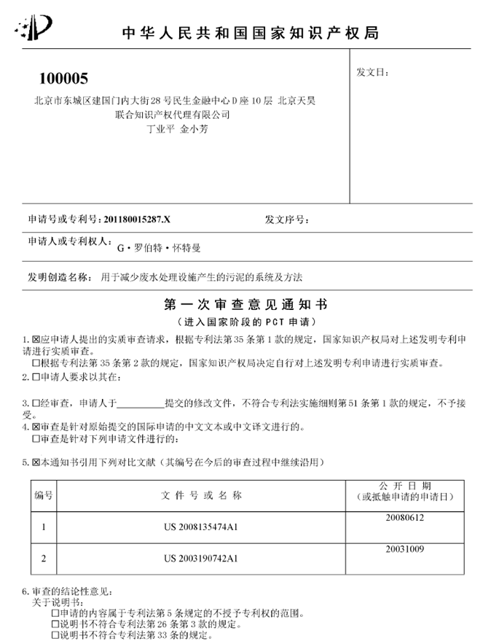
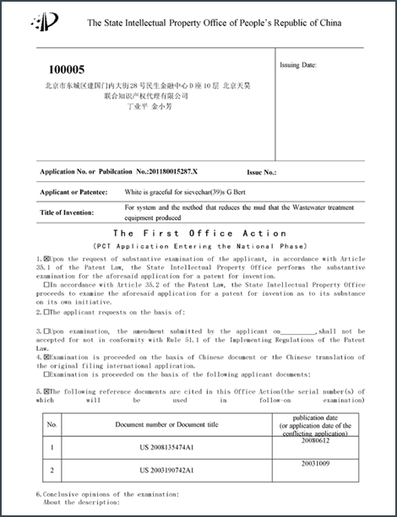
EPO Global Dossier service
欧洲专利局全球案卷服务
IP5 file wrapper portal五大知识产权局的文件包门户
Access to IP5 patent family information访问五大知识产权局的专利家族信息
On-the-fly machine translation from Asian languages to English亚洲语言到英语的即时机器翻译
Free of charge免费
Via the European Register and Espacenet通过欧洲法律状态查询和欧洲专利数据库使用
US data since June 2015 2015年6月以来的美国数据
Example from Chinese file wrapper:中国历史文件包示例： First Office Action in the original Chinese language and the translation into English原文为汉语和翻译成英语的初步审查决定书

Slide 34
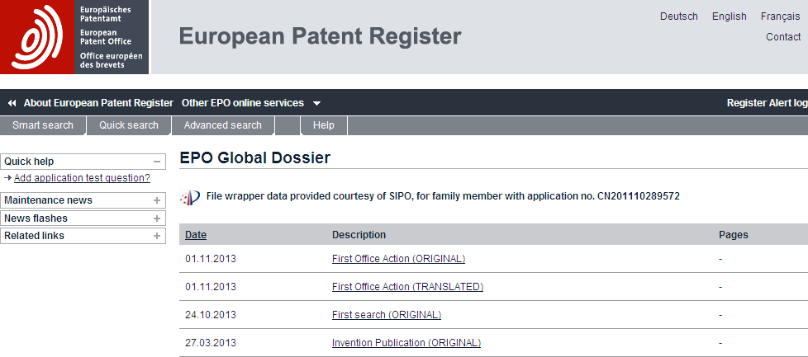
Automatic translation between English and 31 other languages, including Chinese, Japanese, Korean and Russian.英语和31种其他语言（包括汉语、日语、韩语和俄语）之间的自动翻译

Slide 35
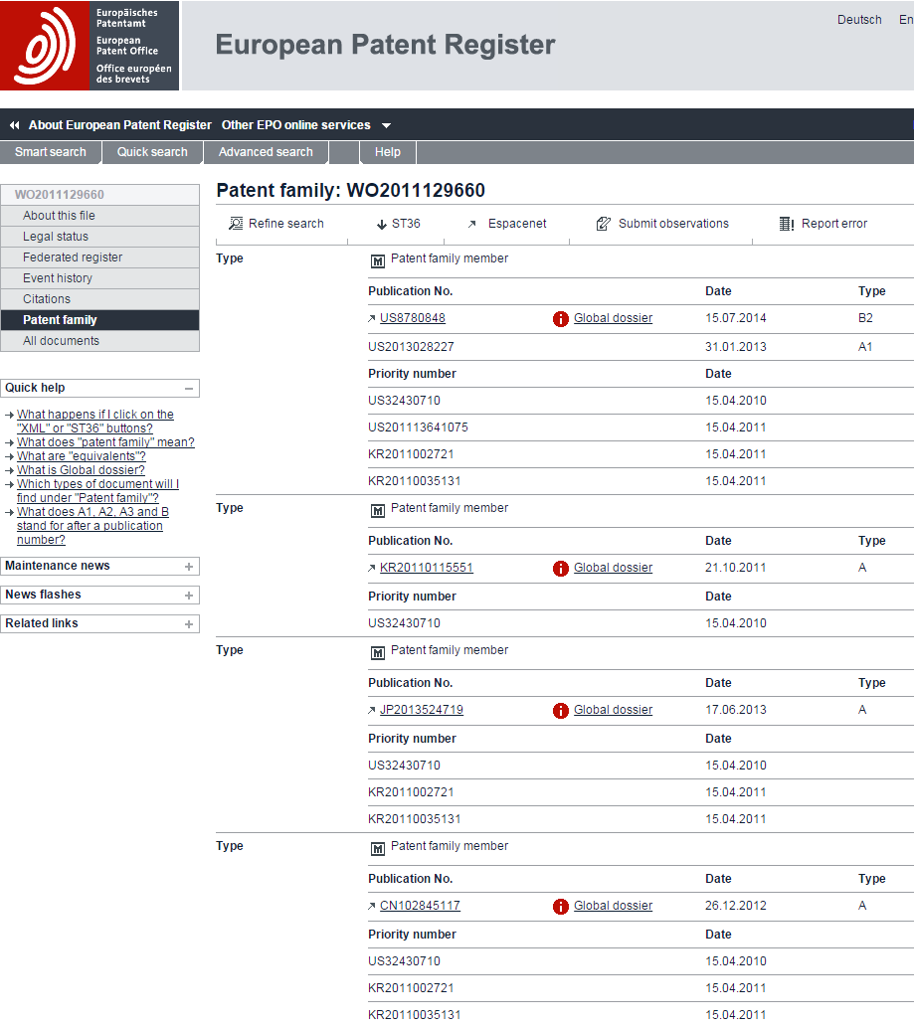
The EPO’s Global Dossier
欧洲专利局的全球案卷
USPTO file wrappers since 06/15美国专利和商标局2015年6月以来的文件包
KIPO and JPO file wrappers since 03/15韩国知识产权局和日本专利局2015年3月以来的文件包
SIPO file wrappers since 06/14中国国家知识产权局2014年6月以来的文件包

Slide 36
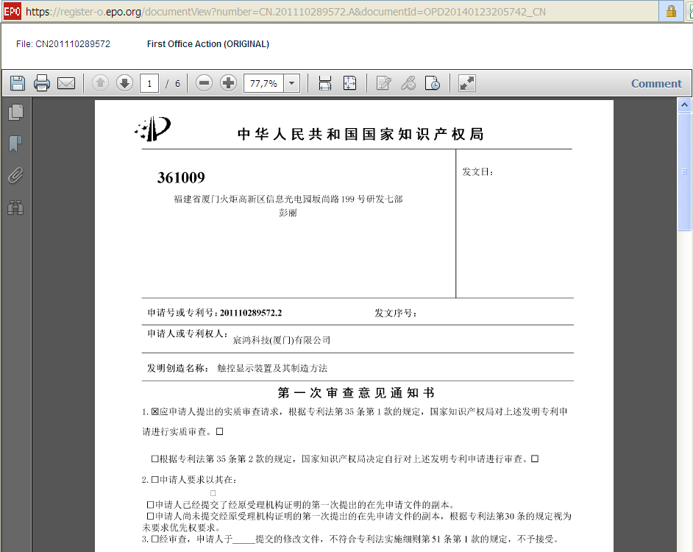

Slide 37
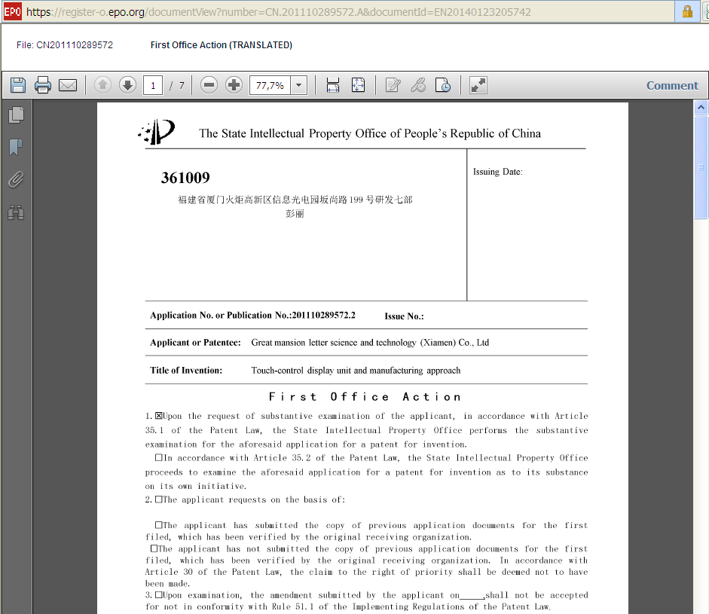

Slide 38
Usage June 2015 – June 2016
2015年6月至2016年6月的使用情况
60 000 unique visitors per month from outside Europe
每月有来自欧洲以外的60,000访客
Accesses by unique visitor monthly 2015-2016
2015年至2016年每月的绝对访客访问
EPO GD public Services
欧洲专利局的全球案卷公共服务

Slide 39
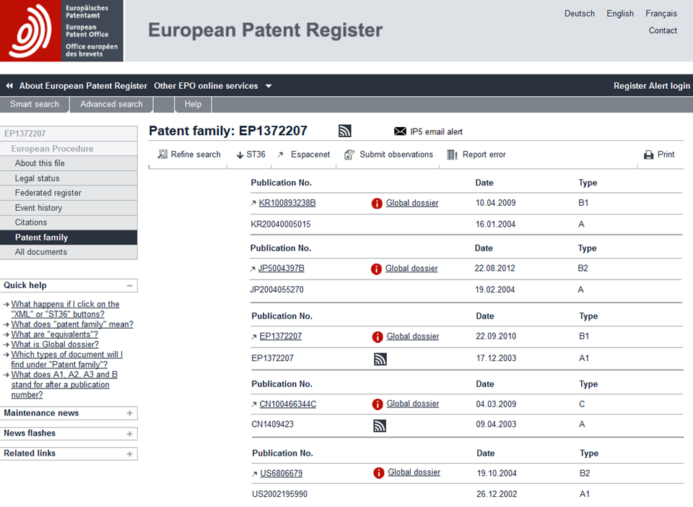
Each IP5 Office develops a publicly available “RSS feed” for File Wrapper五大知识产权局中的每一家均为文件包开发了公开提供的“RSS源”
EPO to deliver email “IP5 Family Alert” for all available IP5 File Wrappers欧洲专利局为所有可用的五大知识产权局文件包发送“五大知识产权局家族通知”电子邮件
RSS feed can also be used by Patent Management Systems RSS源还可通过专利管理系统使用
European Patent Office欧洲专利局

Slide 40
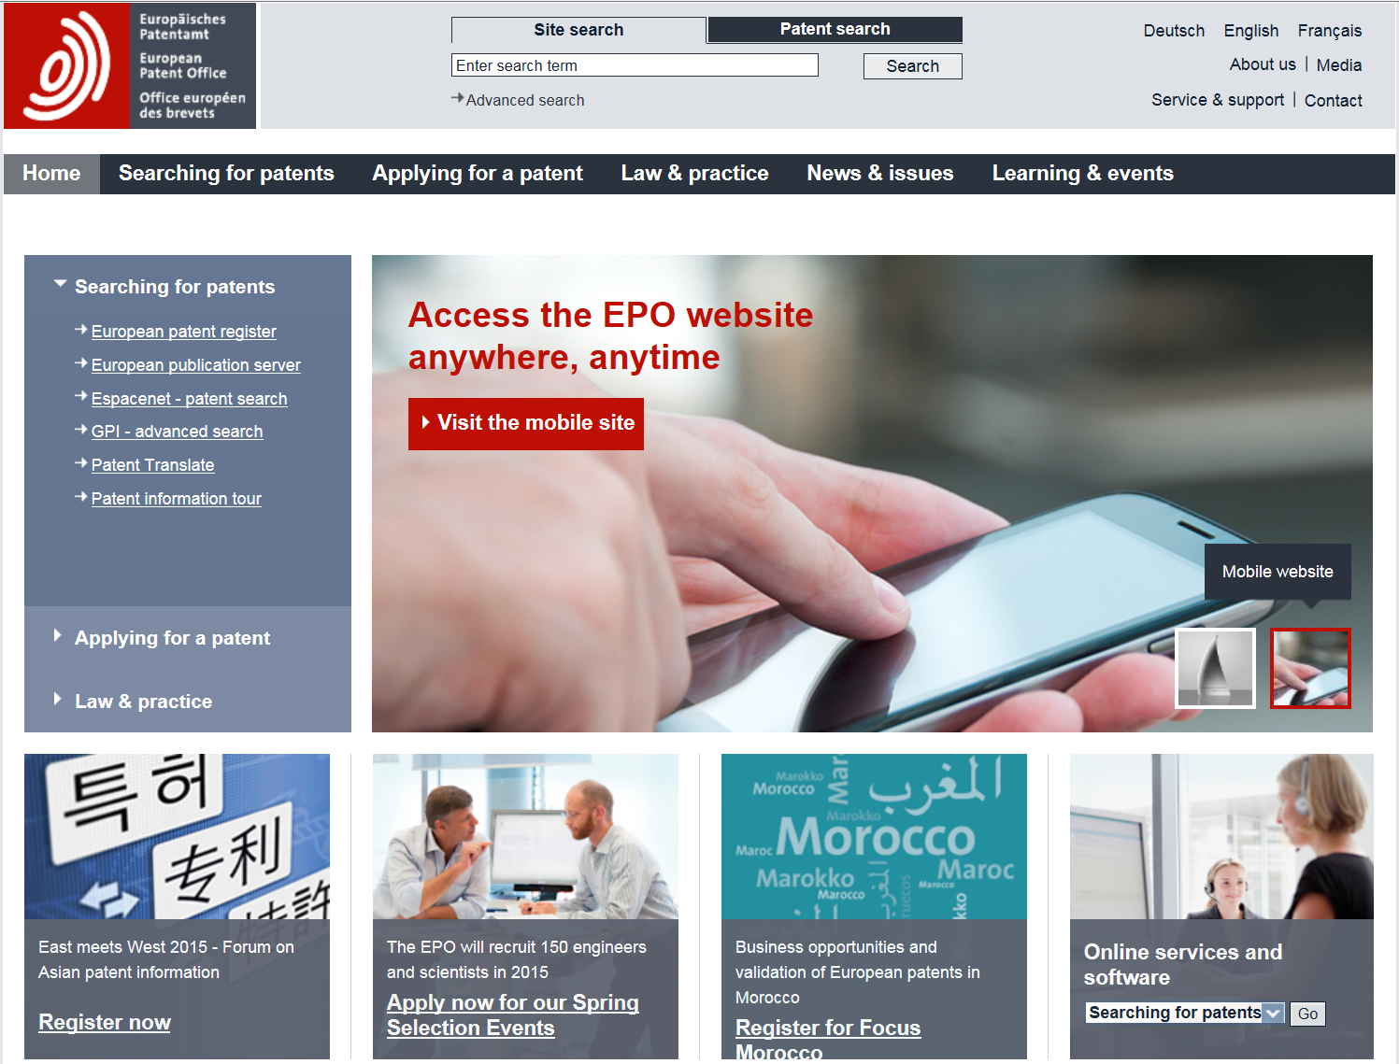
All patent documents are accessible free of charge on www.epo.org所有专利文件均可在www.epo.org免费访问
Espacenet欧洲专利数据库
over 90 million patent documents, easily searchable
逾9,000万份专利文件，
易于检索
Patent Translate专利翻译
Automatic translation
between English and 31 other languages,
including Chinese,
Japanese, Korean
and Russian.
英语和31种其他语言
（包括汉语、日语、韩语和
俄语）之间的自动翻译

Slide 41
Key facts about Espacenet
关于欧洲专利数据库的重要事实
Most visited area of our website, with around 20 million visits every year是我们网站上访问量最大的版块，每年访问量达到约2,000万
A worldwide collection of patent data收集全球专利数据
For beginners and experts 为新手和专家提供服务
Automatic translation of documents between English and 31 other languages, including Chinese, Japanese, Korean and Russian.提供英语和31种其他语言（包括汉语、日语、韩语和俄语）之间的自动文件翻译

Slide 42
Early Certainty from Search (ECfS)
始于检索的早期确定性 (ECfS)
EPO delivers not only a high quality prior art search, now also timely!欧洲专利局不仅提供而且现在是及时提供优质的现有技术检索！
Target set in July 2014: all EPO searches to be delivered within 6 months !2014年6月设定的目标：欧洲专利局的所有检索报告均在6个月内交付！
As of July 2016, all search backlogs were dissolved.截至2016年7月，所有积压的检索任务均已得到解决。
EPO has adopted a better examiner work priority model, called ECfS.欧洲专利局已经采取更好的审查员工作优先模式（称作“始于检索的早期确定性”）。
No distinction by origin of file ... only by product type不按文件来源区分……仅按产品类型区分
Next to be tackled will be examination backlogs.接下来要解决的是积压的审查任务。
Need for more speed in examination:需要提高审查速度：use PACE and ENQUIRIES!使用欧洲专利申请加快审查程序(PACE)和查询！

Slide 43
Early Certainty from Search始于检索的早期确定性
The goal was achieved:目标已经实现：All new searches with opinion issued within 6 months所有附意见的新检索报告均在6个月内出具
图表表明了1项积压检索的优先权，每一位审查员的1个文档是虚拟的最小值。

Slide 44
Benefits for All各方均受益
Early information from search and written opinion on patentability始于检索的早期确定性和可专利性书面意见
search results and opinion on technical contribution and patentability provides early information to support decision making for applicants, competitors and the public检索结果以及技术贡献和可专利性意见提供早期信息以为申请人、竞争对手和公众的决策提供支持
Applicants and third parties申请人和第三方
Able to accelerate prosecution可加快执行
No blind spots in European IP欧洲知识产权无盲点
All searches with written opinion issued on time按时出具附书面意见的所有检索报告
Examination efficiency & focus审查效率和重点
started examination completed promptly已开始的审查及时完成
similar communication response time limits for examiners and applicants审查员和申请人的类似沟通反应时间限制
Fast track grant快速授予
Expedited grant in case positive search opinion or IPER如果检索意见或国际初步审查报告是正面的，则加快授予

Slide 45
ECfS is producing the expected results
“始于检索的早期确定性”计划在产生预期的效果
2015 Highlights 2015年亮点
Search backlog fell by two thirds.积压的检索任务减少了三分之二。
Median time to Grant is 28 months from filing of the examination request从审查申请提交到授予平均需要28个月
More than 85% of search reports with written opinions on patentability were delivered within six months from filing 85%以上附可专利性书面意见的检索报告在申请后6个月内出具
Over 90% of international search reports were ready in time for “A1”-publication. 90%以上的国际检索报告为A1公布而及时出具。
Looking forward展望
As search backlog is cleared, focus moves to examination随着积压的检索任务得以解决，重点转向审查

Slide 46
What is next? Early Certainty across all processes 接下来？ 始于所有流程的早期确定性
The EPO has set the following objectives:
欧洲专利局已经设定如下目标：
Early Certainty from ...始于……检索的早期确定性 ECfS
Prior art search and written opinion within 6 months
6个月内出具现有技术检索报告和书面意见
Early Certainty from ...始于……审查的早期确定性 ECfE
Grants (up to IGRA) on average within 12 months
平均12个月内授予（直到IGRA）
Early Certainty from ...始于……异议的早期确定性 ECfO
Standard Opposition within 15 months
15个月内出具标准异议报告

Slide 47
Early Certainty...from examination (ECfE)
始于审查的早期确定性
Creates clarity on patent rights for all applicant, competitor & public明确所有申请人、竞争对手和公众的专利权
High quality of patents高质量的专利
Available insight, so patents delivered in time洞察力强，因此及时交付专利
no blind spots, applicant timely information to decide, ...无盲点，供申请人决策的及时信息，……
... patent pending ... ……专利未决……
It is the right thing to do and in line with EPO Mission Statement:应当做的正确事情并符合欧洲专利局的使命宣言：
“As the Patent Office for Europe, we support innovation, competitiveness and economic growth across Europe through a commitment to high quality and efficient services delivered under the EPC”“作为欧洲的专利局，我们致力于按照《欧洲专利公约》提供优质而高效的服务，从而为整个欧洲的创新、竞争力和经济增长提供支持。”

Slide 48
Early Certainty ... from Examination: how ?
始于……审查的早期确定性：如何做？
EPO pursues its Quality Efficiency Strategy欧洲专利局执行其优质高效战略
Now proactively remind applicants of possible withdrawal options & incentives (fee refund possibilities changed)现在积极提醒申请人注意可能的撤回选项和激励（费用退还可能性已变动）
Streamlining patent practice, workflows & procedures will support the goal: aiming towards further simplification of procedure: in progress !简化专利作业、工作流程和程序将有助于实现目标：进一步简化程序：正在进行！
Within five years the Paris Criteria will be reached by taking the necessary actions: maintained / improved performance, quality and fostering early withdrawals.五年内，将通过采取必要的行动（保持和提高业绩和质量，促进早期撤回）来达到巴黎标准。
Situations per technical field will be different!情况因技术领域而异！The goal is average delivery in 12 months.目标是平均12个月内交付。

Slide 49
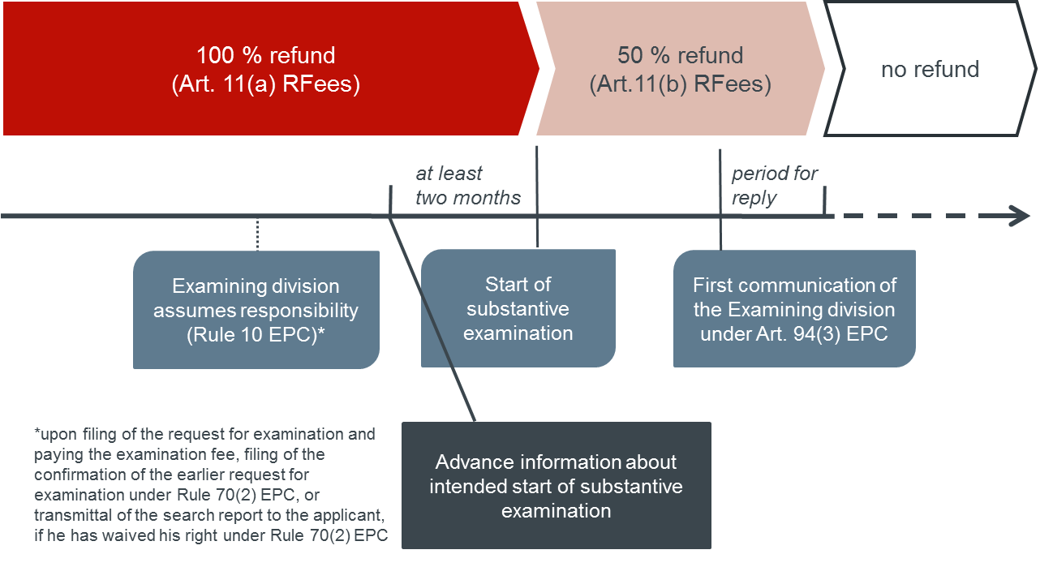
Refund of the examination fee – new situation 退还审查费——新情况
Non-direct grant cases (at least one examiner communication)
未直接授予案例（至少一位审查员沟通）
退还100%
（第11(a)条“费用退还”）
退还50%
（第11(b)条“费用退还”）
不退还
至少两个月
回复期限
审查部门承担责任
（《欧洲专利公约》第10条）
开始实质性审查
审查部门根据《欧洲专利公约》
第94(3)条作出的首次沟通
关于实质性审查预期开始的预报信息
在提交审查请求、支付审查费、提交根据《欧洲专利公约》第70(2)条作出的之前审查请求的确认书或向申请人传输检索报告后（如果其已放弃其在《欧洲专利公约》第70(2)条项下的权利）。

Slide 50
How to Accelerate Procedure at the EPO
如何加快欧洲专利局的程序
PACE response targets (used for 7% of applications)
欧洲专利申请加快审查程序(PACE)响应目标（用于7%的申请）
3 months for issue of examination communication (current average = 5,9 months) 3个月内出具审查沟通意见（目前平均用5.9个月）
6 months for issue of search report 6个月内出具检索报告
Note:注：Patent Prosecution Highway filings are treated according to PACE按照欧洲专利申请加快审查程序(PACE)处理专利审查高速路申请提交
Third party observations第三方意见
3 months for issue of examination communication 3个月内出具审查沟通意见
(observation must be substantiated & non-anonymous)（意见必须是有根据而且非匿名的）
Positive search opinion & IPER acceleration正面检索意见和国际初步审查报告
4 months for issue of the (R71(3)) communication 4个月内出具（第71(3)条）沟通意见
(following allocation to division)（在分配给相应部门后）

Slide 51
Waivers in the grant procedure – overview 授予程序中的放弃——概述
Purpose:目的：
Accelerate the procedure加快程序
Increase procedural efficiency both for users and the Office为用户和专利局提高程序效率
Waivers and PACE requests are to be distinguished and have to be filed separately:放弃书和欧洲专利申请加快审查程序(PACE)请求要区别开来并分别提交：
PACE is a request to speed up the processing欧洲专利申请加快审查程序(PACE)是加快处理的请求
A waiver is abandoning the right to a communication放弃是指放弃沟通的权利

Slide 52
Waivers in the grant procedure – overview 授予程序中的放弃——概述
Three possibilities to waive a right to a communication:放弃沟通权利的三种可能性：
Further communication under Rule 71(3) EPC根据《欧洲专利公约》第71(3)条作出的进一步沟通
available since 01.07.2015 2015年7月1日起可利用
Before granting the EPO will inform the applicant of the text in which it intends to grant.授予前，欧洲专利局将把其授予时将使用的文本告知申请人。Invitation to pay the fees and to file a translation of the claims in the other two official languages.请申请人支付费用并提交另外两种官方语言的权利要求译文。
Invitation under Rule 70(2) EPC根据《欧洲专利公约》第70(2)条发出的邀请
If request for examination filed before the search report transmitted to the applicant, the European Patent Office shall invite the applicant to indicate whether he wishes to proceed further with the application, and give the opportunity to comment on the search report and to amend, where appropriate, the description, claims and drawings.如果审查请求是在检索报告传输给申请人之前提交的，则欧洲专利局应请申请人说明其是否愿意继续申请并向申请人提供评价检索报告和修改（在适当情况下）描述、权利要求和附图的机会。
Communication under Rules 161/162 EPC根据《欧洲专利公约》第161条/第162条作出的沟通
(1) If the EPO acted as the IPEA for a Euro-PCT application, it shall give the applicant the opportunity to comment on the opinion of the ISA or the IPER and to correct deficiencies.如果欧洲专利局是欧洲-PCT申请的国际初步审查单位，则其应向申请人提供评价国际检索机构意见或国际初步审查报告并纠正不足之处的机会。If the EPO acted as SISA, ditto.如果欧洲专利局为补充国际检索单位，则同样如此。
(2) Where the EPO draws up a supplementary European search report on a Euro-PCT application, the application may be amended once within six months from a communication informing the applicant accordingly.如果欧洲专利局起草欧洲-PCT申请的补充欧洲检索报告，则申请可在自相应通知申请人的沟通之日起6个月内修改一次。The application as amended serves as the basis for the supplementary European search.修改后的申请为补充欧洲检索的依据。

Slide 53
Euro-PCT application, EPO was not the ISA 欧洲-PCT申请，欧洲专利局不是国际检索单位
Rule 161/162 waiver (saving 6 months) 按照《欧洲专利公约》
第161条/第162条放弃（节省6个月）
Rule 70(2) waiver (saving 6 months) 按照《欧洲专利公约》
第70(2)条放弃（节省6个月）
Rule 71(3) waiver (saving 4 months)按照《欧洲专利公约》
第71(3)条放弃（节省4个月）
Filing
提交
31 months
31个月
Search
report检索报告
Intention
to grant授予意向
International phase国际阶段
Supplementary
European search补充欧洲检索
Examination审查
Further option:进一步选项：PACE request accelerates processing by the EPO as from the moment the request is filed欧洲专利申请加快审查程序(PACE)请求从请求得以提交的那一刻起加快欧洲专利局的处理速度
PACE request and waivers have to be filed separately for full acceleration benefit欧洲专利申请加快审查程序(PACE)请求书和放弃书须分别提交以充分获得加速处理

Slide 54
Early Entry into the European Phase早日进入欧洲阶段 (Request for early processing) （早期处理的请求）
Until expiry of 31 months from filing/priority the EPO as designated/elected Office may not start processing the application自提交/优先权之日起31个月到期之前，欧洲专利局作为指定/选定的专利局不可开始处理申请
Articles 22(3)/39(1)(b) PCT, Rule 159 EPC
《专利合作条约》第22(3)条/第39(1)(b)条，《欧洲专利公约》第159条
Prohibition to process during the entire (extended) international phase禁止在整个（延长的）国际阶段处理 → “Processing prohibition处理禁止” Articles 23(1)/40(1) PCT 《专利合作条约》第23(1)条/第40(1)条
0
12
31
Priority period优先权期限
International phase国际阶段
European phase欧洲阶段

Slide 55
Entry into the European phase after 31 months
31个月后进入欧洲阶段
(regular entry)（常规进入）
After the 31-month period “automatic” start of the “European phase”, i.e. the processing of the application by the EPO as designated/elected Office在31个月后“自动”开始“欧洲阶段”，即欧洲专利局作为指定局/选定局处理申请
If not all requirements of Rule 159 EPC are met within 31 months:如果未在31个月内满足《欧洲专利公约》第159条的所有要求，则：
Loss of rights, application is deemed withdrawn丧失权利，申请被视为撤回 Rule 160 EPC, Articles 24(1)/39(2) PCT
《欧洲专利公约》第161条，《专利合作条约》第24(1)条/第39(2)条
Further processing may be requested可能要求进一步处理
Rule 135 EPC
《欧洲专利公约》第135条

Slide 56
Request for early processing
早日处理的请求
Only the applicant may lift the processing ban仅申请人可取消处理禁令
Requirements:要求：
Explicit request for early processing早日处理的明确请求
Preferably with explicit reference to Articles 23(2)/40(2) PCT最好明确提及《专利合作条约》第23(2)条/第40(2)条
Possible until the last day of the 31-month period在31个月的最后一天之后可能 J 18/09
Form 1200 and payment of all fees without explicit request is not regarded as request for early processing表1200和支付未明确要求支付的所有费用不被视为早日处理的请求
Comply with the requirements of Rule 159 EPC as if the 31-month period expired on the date early processing is requested像31个月期限于早日处理的请求发出之日到期一样遵守《欧洲专利公约》第159条的要求

Slide 57
Number of requests for early processing
早日处理申请的数量

Slide 58
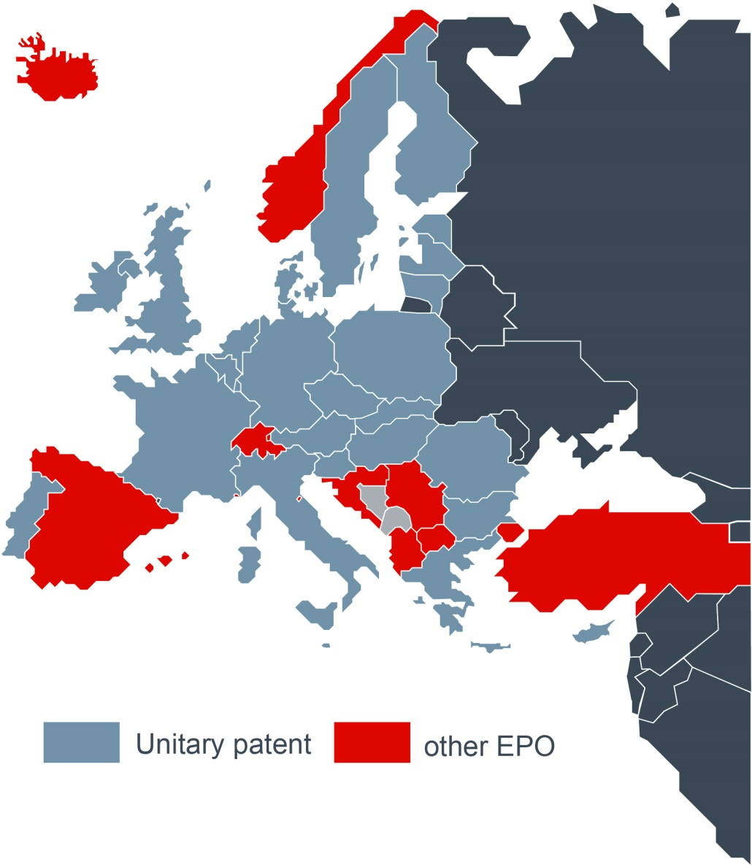
The unitary patent and the EPO member states
单一专利制度和欧洲专利局成员国
Unitary patent states接受单一专利制度的国家
Austria奥地利 • Belgium比利时 • Bulgaria保加利亚 • Cyprus塞浦路斯 Czech Republic捷克共和国 • Denmark丹麦 • Estonia爱沙尼亚 Finland芬兰 • France法国 • Germany德国
Greece希腊 • Hungary匈牙利 • Ireland爱尔兰 • Italy意大利 Latvia拉脱维亚 • Lithuania立陶宛 • Luxembourg卢森堡
Malta马耳他 • Netherlands荷兰 • Poland波兰
Portugal葡萄牙 • Romania罗马尼亚 • Slovakia斯洛伐克
Slovenia斯洛文尼亚 • Sweden瑞典 • United Kingdom英国
Other EPO member states欧洲专利局的其他成员国
Spain西班牙 • Iceland冰岛 • Switzerland瑞士
Norway挪威 • Turkey土耳其 • Monaco摩纳哥
San Marino圣马力诺 • Liechtenstein列支敦斯登 • Croatia克罗地亚 Serbia塞尔维亚 • Albania阿尔巴尼亚 • Former Yugoslav Republic of Macedonia前南斯拉夫马其顿共和国
单一专利
其他欧洲专利局

Slide 59
Unitary Patent – Final preparations
统一专利——最后准备
EPO preparations欧洲专利局的准备 ► Completed已完成
Breakthrough on the legal implementation in December 2015 – adoption of complete secondary legal framework, including:2015年11月的法律实施实现突破——采用完整的次级法律框架，包括： implementing rules, budgetary and financial rules, the level and distribution of the renewal fees.实施规则、预算和财务规则、续展费的级别和分配。 Finalisation of the technical implementation about to be concluded.技术实施的最终确定即将完成。
Member States preparations成员国的准备 ► Ongoing持续进行
Ongoing ratifications of the UPC Agreement by participating Member States.参与的成员国持续批准《单一专利法院协议》。 11 out of the 13 necessary states have ratified so far and a number of others have planned to ratify in 2016.目前，13个必需的国家中有11个已经批准，另有几个国家计划于2016年批准。 Brexit:英国脱欧： Ways will be sought for the Unitary Patent package to go ahead and to enter into operation as soon as possible.将为单一专利制度套餐寻求继续并尽早投入运作的方法
Note:注：Brexit does not affect the UK’s membership of the European Patent Organisation; Applicants will be able to continue to designate the UK; granted European patents can include the UK in the basket of national patents if the Applicant so wishes.英国脱欧不影响英国在欧洲专利局的成员资格；申请人可以继续指定英国；如果申请人愿意，则已获授予的欧洲专利可将英国纳入国家专利篮子。

Slide 60
Practical Tips for Filing at the EPO
向欧洲专利局提交申请的实用技巧
The Description描述
Great attention should be paid to preparation of the description.应高度关注描述的撰写。
The invention must be disclosed in a manner sufficiently
clear and complete for it to be carried out by a person skilled in the
art.发明必须以足够清晰和完整、可由本领域技术人员实施的方式披露。If it is not, the application is likely to encounter difficulties.否则，申请可能遇到困难。
Art. 123(2) problems can be avoided if the description provides a clear basis for amending the claims.如果描述提供修改权利要求的明确依据，则可避免第123(2)条的问题。
Refer to the relevant prior art and state the problem the invention seeks to solve, according to the problem-solution approach.提及相关现有技术并按照问题-解决方案方法说明发明寻求解决的问题。

Slide 61
Practical Tips for Filing at the EPO
向欧洲专利局提交申请的实用技巧
The Claims权利要求
Quality and efficiency of the search and examination procedure is enhanced when:在如下情况下，检索和审查程序的质量和效率将会提高：
Claims are clear and concise, provide proper fall-back positions and include all essential features of the invention.权利要求简明扼要，提供适当的让步立场，并包括发明的所有基本特征。
Claims meet the requirements as to unity of invention.权利要求符合对发明单一性的要求。
Claims avoid multiple use of the expression “and/or“ (lack of clarity)权利要求避免多次使用“和/或”表达（缺乏明确性）
Multiple independent claims in the same category which do not comply with Rule 43(2) often result in an invitation under Rule 62a.同一类别、不符合第43(2)条的多个独立权利要求通常导致第62a条项下的邀请。The examiner may search only the first claim in each category, even if it is not the claim in which the applicant is most interested.审查员可仅检索每个类别的第一个权利要求，即便第一个权利要求不是与申请人最有利害关系的。

Slide 62
Total European patent applications in 2015
2015年的欧洲专利申请总量
142 822
148 562
148 027
152 703
160 022
+4.8%
2015
Applications are the files for which applicants have decided to request a European patent from the EPO. They are a direct measure of the explicit interest of innovating firms to assert their patent rights on the European technology market (Direct European applications and international (PCT) applications entering the European phase).申请文件是指申请人决定请求欧洲专利局授予欧洲专利的文件。 申请文件直接体现创新企业主张其在欧洲技术市场上（直接欧洲申请和进入欧洲阶段的国际PCT申请）专利权的明确利益。

Slide 63
Origin of European patent applications in 2015
2015年欧洲专利申请的来源
Others其他 5%
P.R.China中国 4%
S. Korea韩国 4%
Germany德国 16%
Japan日本 13%
France法国 7%
Netherlands荷兰 4%
EPO member states欧洲专利局成员国 47%
Switzerland瑞士 4%
United Kingdom英国 3%
Italy意大利 2%
United States 27%
Sweden瑞典 2%
Other EPO member states
欧洲专利局其他成员国 8%
Analysis based on European patent applications filed with the EPO (Direct European applications and international (PCT) applications entering the European phase).分析基于向欧洲专利局提交的欧洲专利申请（直接欧洲申请和进入欧洲阶段的国际PCT申请）。
Statistics are based on the first-named applicant.统计基于名字排在第一位的申请人。
EPO: the 38 member states of the European Patent Organisation, including EU28欧洲专利局：欧洲专利组织的38个成员国，包括欧盟28国

Slide 64
Technical fields with the most applications in 2015
2015年申请数量最多的技术领域
TOP 10
前10位
 |  | 2015 | Change 变动
1 | Medical technology医疗技术 | 12 474 | 11.0%
2 | Digital communication数字通信 | 10 762 | 3.2%
3 | Computer technology计算机技术 | 10 549 | 7.8%
4 | Electrical machinery, apparatus, energy 电气机械、设备、能源 | 10 198 | -1.8%
5 | Transport运输 | 7 802 | -1.6%
6 | Measurement计量 | 7 727 | 8.0%
7 | Organic fine chemistry精细有机化学 | 6 414 | 2.1%
8 | Engines, pumps, turbines发动机、泵、涡轮机 | 6 374 | 17.9%
9 | Biotechnology生物技术 | 6 048 | 5.1%
10 | Pharmaceuticals制药 | 5 884 | 9.6%
Analysis based on European patent applications filed with the EPO (Direct European applications and international (PCT) applications entering the European phase).分析基于向欧洲专利局提交的欧洲专利申请（直接欧洲申请和进入欧洲阶段的国际PCT申请）。

Slide 65
Top EPO applicants in 2015
2015年欧洲专利局申请数量最多的申请人
TOP 10
前10位
 |  | 2015 | Change变动
1 | Philips飞利浦 | 2 402 | 3.7%
2 | Samsung三星 | 2 366 | -6.9%
3 | LG乐金 | 2 091 | 27.7%
4 | Huawei华为 | 1 953 | 22.1%
5 | Siemens西门子 | 1 894 | -11.2%
6 | United Technologies联合技术 | 1 869 | 110.0%
7 | Qualcomm高通 | 1 705 | 16.9%
8 | Robert Bosch罗伯特博世 | 1 493 | 3.8%
9 | BASF巴斯夫 | 1 384 | -9.5%
10 | General Electric通用电气 | 1 316 | 57.0%
EPO member states欧洲专利局成员国
United States美国
S. Korea韩国
P.R.China中国
Analysis based on European patent applications filed with the EPO (Direct European applications and international (PCT) applications entering the European phase). Statistics are based on the first-named applicant. 分析基于向欧洲专利局提交的欧洲专利申请（直接欧洲申请和进入欧洲阶段的国际PCT申请）。 统计基于名字排在第一位的申请人。

Slide 66
Granted patents in 2015
2015年授予的专利
Others其他 4%
P.R.China中国 2%
S. Korea韩国 3%
Germany德国 21%
Japan日本 16%
France法国 8%
EPO member states欧洲专利局成员国 53%
Switzerland瑞士 4%
Netherlands荷兰 3%
United Kingdom英国 3%
United States 22%
Italy意大利 3%
Sweden瑞典 3%
Other EPO member states
欧洲专利局其他成员国 8%
Analysis based on granted patents published in 2015.分析基于2015年公布的已授予专利。Statistics are based on the first-named patentee.统计基于名字排在第一位的专利权所有人。

Slide 67
Need more information?
需要更多信息？
Visit www.epo.org 访问www.epo.org
Follow us on 通过以下网站关注我们：
www.facebook.com/europeanpatentoffice
twitter.com/EPOorg
www.youtube.com/EPOfilms
www.linkedin.com/company/european-patent-office
Contact us via www.epo.org/contact通过www.epo.org/contact联系我们

